Slide 1
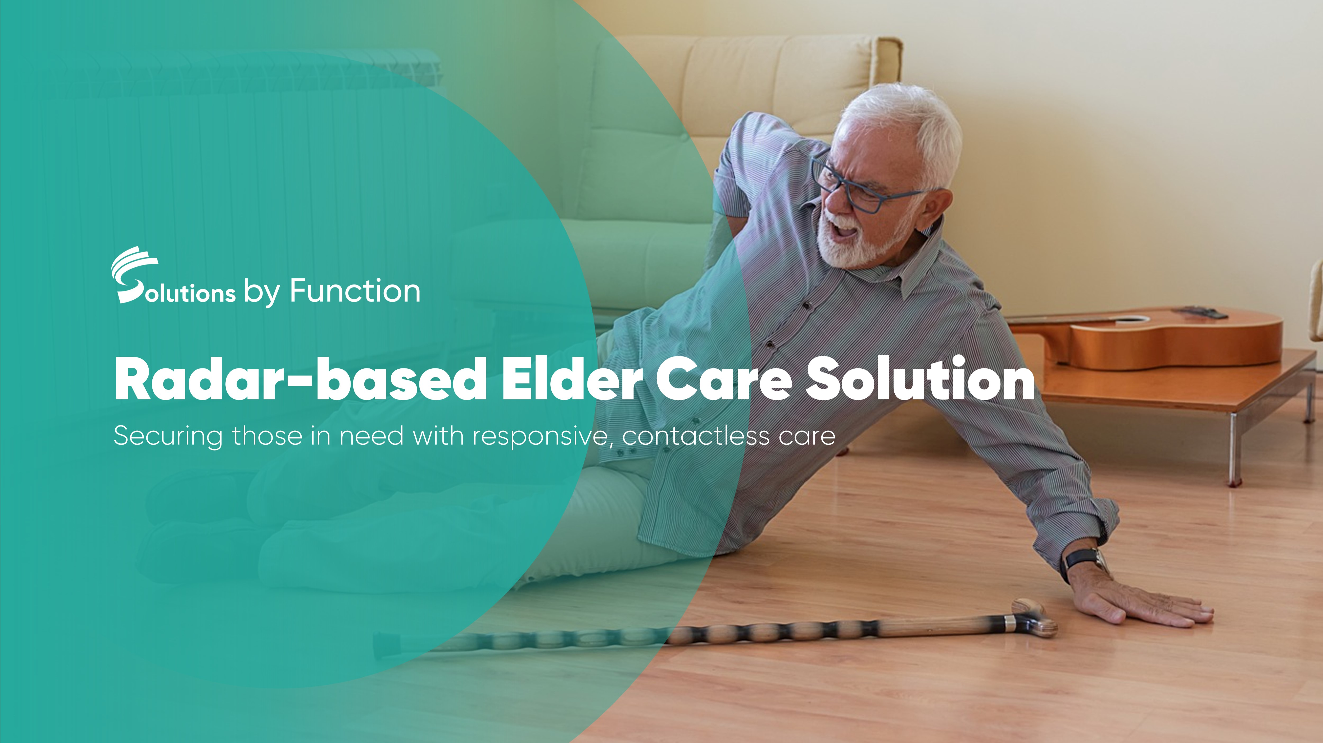

Slide 2


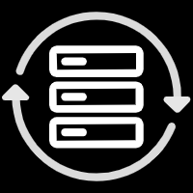
The Current Situation of Elder Care Industry
Aging Population
Problems Existing in The Elder Care Industry
Globally, the home care industry suffers from workforce shortages, as the demand for home care aides outstrips supply.
The shortage of long-term care worker
In UK, the adult care worker had a vacancy rate of 8.2%, more than twice the UK average. The sector is facing a daunting shortage of 105,000 workers.
(16%)
Status of long-term care workers
Fewer employees and more mobility
Low income
Long working hours
(9%)
(5%)
In particular, Japan is the most prominent, with an aging population of 29% by 2021. And Europe reached 20.3%.
For the elder over 65,the average lifetime after retirement is 20 years, and the future trend is increasing.
Healthcare Digitization is the Solution to the Challenges
Save labor costs
Improving the efficiency of the organization
UN define: if a country has 7% of its population over 65, It can be defined as an "aging country".
Notes:
As the united nations defines, that if a country has more than 7% people who aged over 65, it can be called a aging country.
And we can see that till the last year, the people who aged over 65 has increase to 9%, which means we are now in the aging time.
1)Especially in some developed countries, such as Japan, Japan, this number has reached 29% ,And in Europe，it has been 20.3%. It means, There is one elder in every four people.
2)In addition, when the elderly retire at the age of 65, they will spend 10-20 years in nursing homes.
But, On the other side, there are also some problems in the elder care industry.
First, is the shortage of care workers, In UK, they have a vacancy of 105,000 workers.
Besides, their status are also very poor, they usually work long time with low income.
So, obviously, the digitization of healthcare are very important, we have big challenges and opportunities, and our solutions are aimed at save labor costs, and improve the efficiency for the organization.

Slide 3
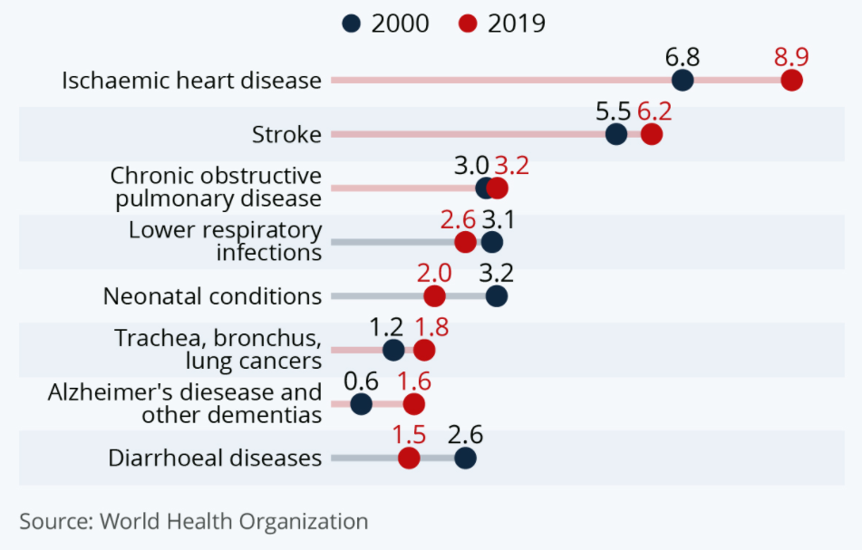
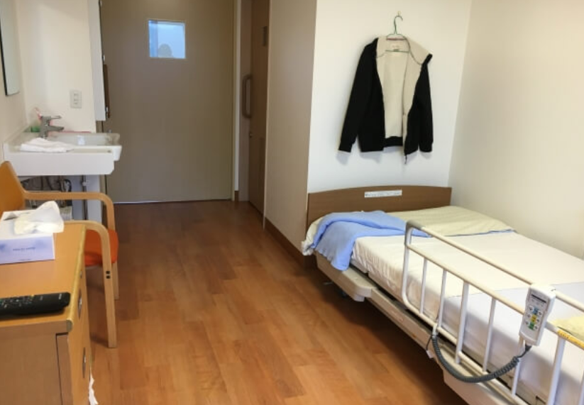
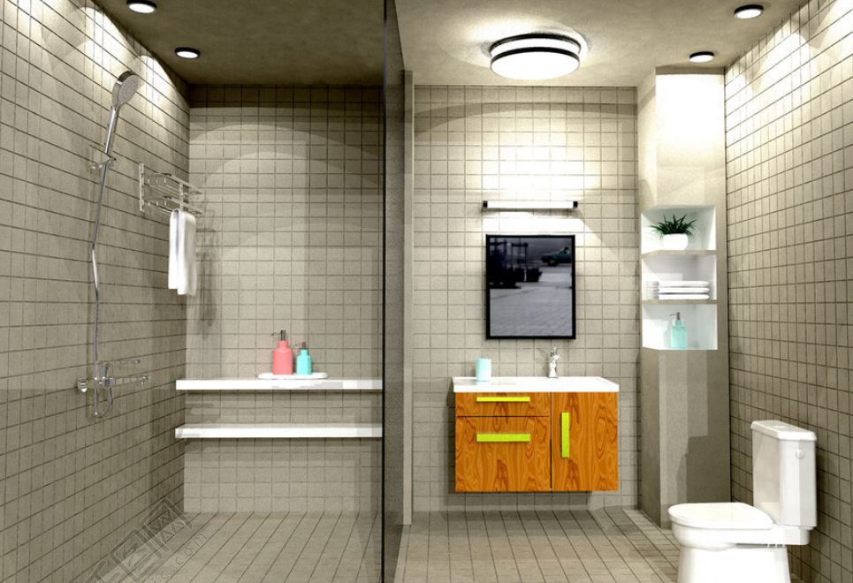
Pain points in the Lives of the Elder
Fear of falling at home
Falls are the primary cause of accidental deaths among the elder
Daily Health Management
Digital health management is needed to find issues at a early stage
Every year, 30% of the elder will occur falls, more than 52%will cause serious accident without detected and treated in time, including fractures and stroke etc.
16%
Bedroom
Main activity area
Clutter is easy to trip and fall
（Bedside, cabinet corner）
Bathroom
Wet bathrooms always cause falls
Sitting on the toilet for too long may cause leg numbness, leading to falls
Cardiovascular diseases(CVDs) are the number one cause of death globally.
Early diagnosis & continuous health monitoring can lower mortality rate by 30%-70%.
Notes:
Today we will focus on two scenarios of elderly care:
-----
First, falling down occurs everywhere and very dangerous, and especially for those elderly。
As the research says, in the nursing home, there are about 30% of the elderly will fall every year. Among them, more than 52% will lead to serious accident without detected and treated in time.
And the bedroom and bathroom are two main spaces where falling down frequently, it‘s hard to avoid run into the bedside or the cabinet corner for the elderly. And wet bathroom is easier to fall down. All these usually be mortally for the elderly.
Meanwhile the daily health management is also important for the elderly, As we can see in the sheet, heart disease and stroke have high rates of death. But early continuous body signs detection can lower mortality rates by 30%-70%.

Slide 4

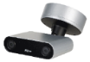

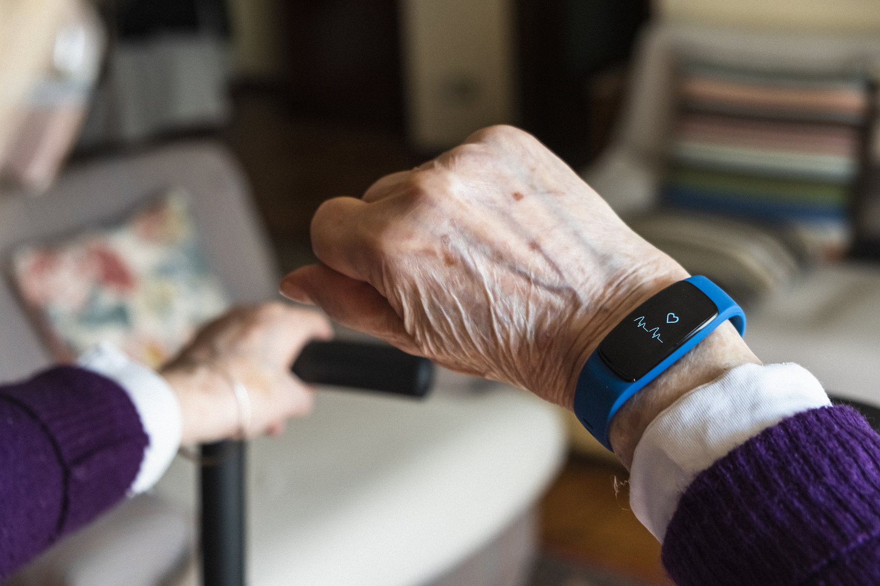

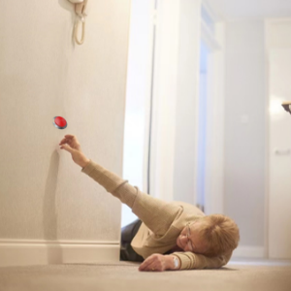

Existing Solutions for the Fall Detection
Existing Solutions
What we Need
Fall Detection Camera
Loss of privacy
Being a constant undersurveilance
Privacy Protection
Elder Watch
Lower comfort degree
Need to charge frequently and wear it all the time
Non-Contact
Emergency Button
Lack of intelligence
Unable to push the button in time
Intelligent
Notes:
Here are three existing solutions of fall prevention,.
First, camera obviously can't be used in the private space, nobody wants to be watched in their room.
Second, the elder watch are the common choice when they need help, but it is uncomfortable for the elderly, so more than 30% old man refuse wear it, even u can accept , u must charge it frequently and keep wearing all the time.
Last, emergency button can‘t work when u lose your consciousness after falling down.
In general, these products are not designed suitable for the elderly
So, what product we need, is a privacy protection, comfortable and intelligent product.

Slide 5
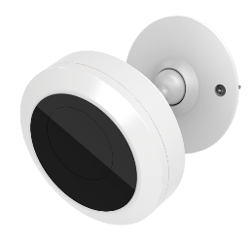









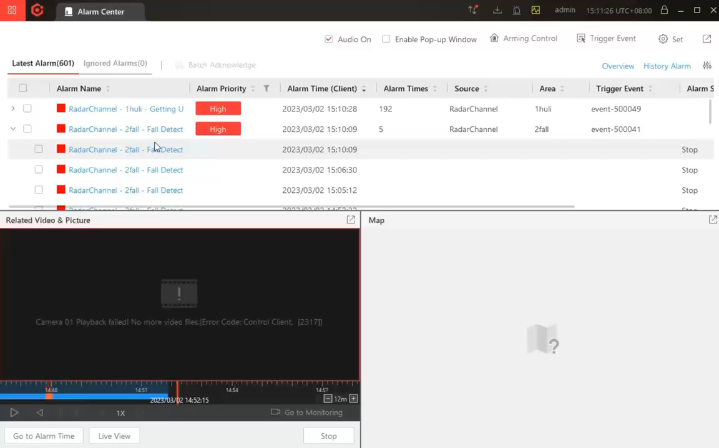
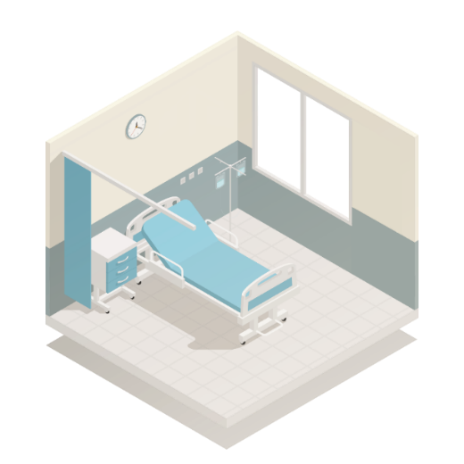







Fall Detection
Automatic warning of abnormal status
Designed For Indoor Prevention
Presence Detector
MASK
Voice
Talk
No Privacy Disclosure
Non-Contact
No Buttons
Alarm linkage video
Privacy protection
Two way talk
Immediate response after a fall
② Activate thermal detector and Intercom
Add visual validation
Thermal Presence
Detector
Reduce false positives
① Send an alarm
Fall Detection
Radar Sensor
Fall alarm
Fall
③ Rescue
Installed in the living room
Alert immediately if a fall occurs
Check and rescue
Notes:
So，let’s see our solutions:
We provide a intelligent radar sensor, which can quickly identify the elder when they fall down in the room, and actively send out a warning to avoid injuries caused by delayed rescue.
Radar’s non-contact design and privacy protection bring our users a more humanized experience.
At the same time, we can link the thermal presence detector to record the fall process. And non-visible video can protect our users‘ privacy.

Slide 6
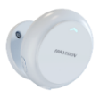



Fall Detection Radar
Key Parameter
Working Frequency | 60 to 64 GHz
Modulation Wave | FMCW
Detection Range | 4 m
Data Cycle | 70 ms
Horizontal & Vertical FoV | -45° to 45°，-45° to 45°
Communication Mode | WIFI, RJ45 interface
Working Voltage | Type-C DC5V IEEE 802.3af POE
Working Electric Current | ≤700mA
Weight | 180 g
Large detection range
The detection area supports a maximum of 10m² (4*2.4m);
For a standard 30m² single room, it is recommended to install two or three devices.
DS-TDSB00-EKT/POE/4M
High accuracy
Bending, sitting, and squatting will not be recognized as falls.
No effect on human body
Using millimeter wave radar, and the radiated power is below 10dbm, which is smaller than mobile phones.
Tips
1. The device cannot pass through walls or glass objects.
2. Please avoid fanner blowing directly at the radar, which will affect the device judgment.
Notes:
跌倒检测雷达：
采用MIMO、波束形成、群跟踪、KNN型识别等技术。它可以获取目标信息，包括人的位置、速度、姿势等，并通过点云数据提供非接触、非隐私的跌倒检测。
跌倒检测原理：
1、物体产生高差(1.2-0.8m);
2、检测物体的轮廓发生变化，雷达成像生成数据形成点云状成像;
3、下落作用的连续性：需要是连续的下落动作；
This part is about the parameters of our product:
We have large detection range about 10 square meters.
Let’s take a example, for a 30m² room, it is recommended to install two or three devices.one in bathroom, another two in bedroom.
It also has high accuracy, our radar can recognize different position, like bending, sitting, and squatting ,and falling down.
Besides, u don’t need worry about our product will be harmful to your body.
In the end, we have two tips for u.
1. The device cannot pass through walls or glass objects.
2. Please avoid fanner in the area covered by the device, which will affect the device judgment.
So, these are the features and values about our fall detection radar.
Next, we will turn to another part.

Slide 7


Thermal Presence Detector
Key Parameter
Resolution | 160*120
Pixel Pitch | 17 μm
Monitoring height | 2.7m
Field of View | 90.0°(H) × 65.3°(V)
Focal Length | 1.9 mm
Communication Mode | WIFI, RS-485
Working Voltage | 5 to 16 VDC,Type-C POE
Alarm Output | 1, alarm output
Weight | 100 g
Privacy protection
Thermal image only, GDPR risk free
Support privacy mask
MASK
QW-HS121
Two way talk
Standard SIP protocol for two way talk
When care center receive alarms, nurse can start two way talk to have a quick check with the elderly
Voice
Talk
Tips
1. The device cannot pass through walls objects.
2. Principle：Identify people by judging the head-to-shoulder ratio of the image and count the number of people.
Notes:
热存在监测:
只有热成像视频画面，并且可以进行马赛克处理；
还能够进行语音对讲；
原理：通过判断图像的头肩比来识别人，并且计算人数;

Slide 8
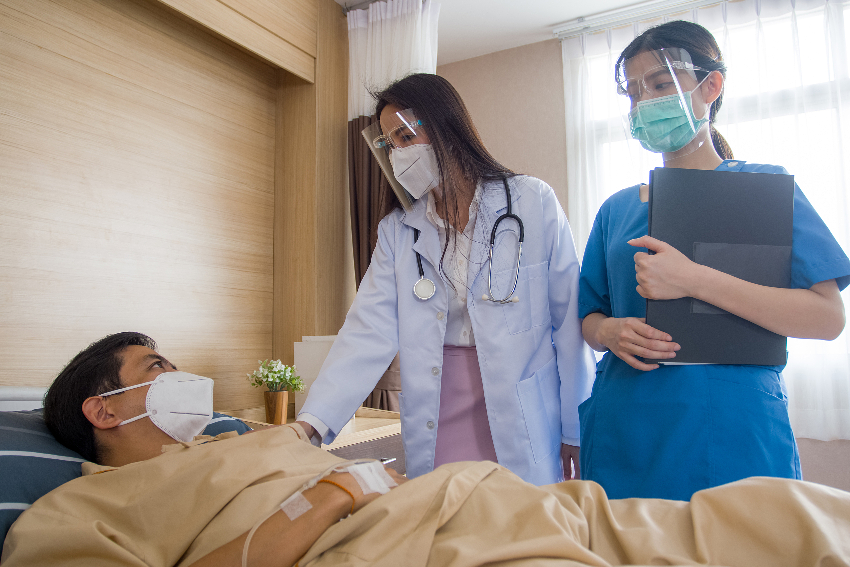
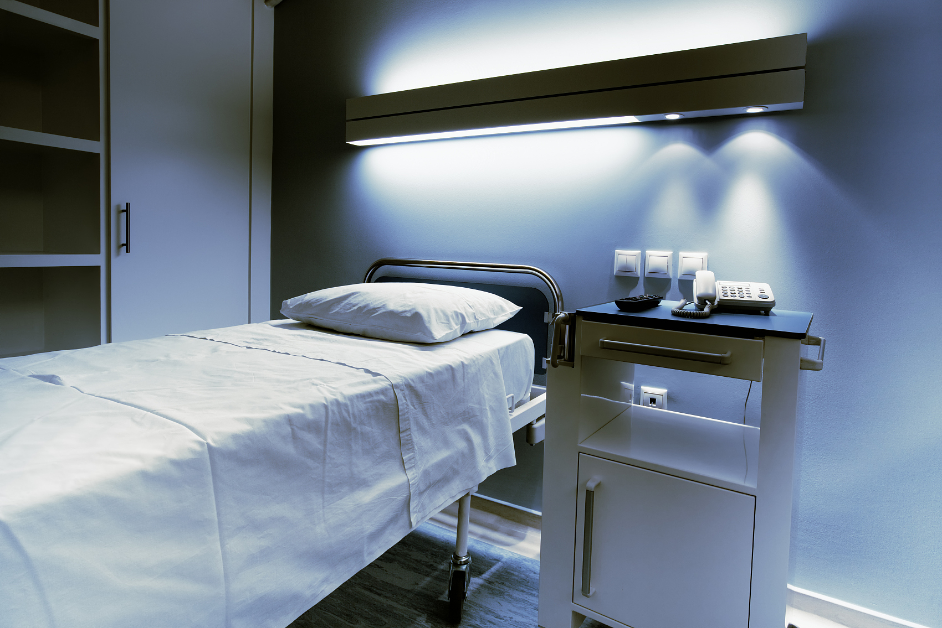

Existing Issues in Nursing Home Service
Pain Points
What We Need
Inefficient daily ward rounds
Go from room to room may cost a lot of time
Unable to know the status of elder in real time
View if everyone is in bed in real time
Lack of precise and meticulous management
Abnormal events alarm facilitate timely action
Lack of long-term health data records
Lack of evidence such as sleep quality, heart rate to detect disease at an early stage
Daily basic vital signs and sleep data
Notes:
For most nursing home, the staff need do ward rounds everyday, it is very inefficient for them.
And they are lack of Precise and meticulous management;
And they don’t have the health data of the elderly.
So, it’s obvious what we need.
It will be better to know everyone whether in bed when we need
And abnormal events alarm can help us take action in time
And, basic vital signs and sleep data are also very useful

Slide 9

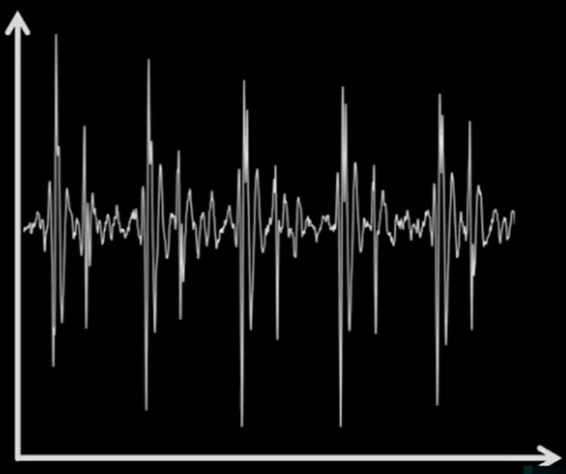
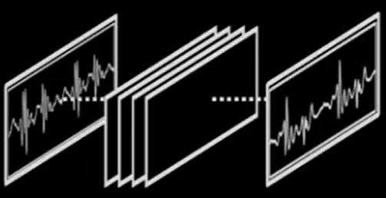
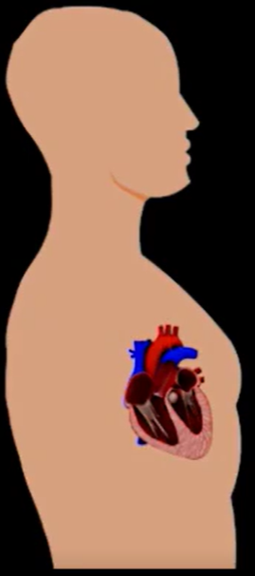

Auxiliary Care Radar
The device send a wireless signal，which reflects human body and comes back；
Contraction
& Relaxation
Every time the heart/chest contracts and relaxes, the device translate the wireless reflection into SCG；
The algorithm learns and identifies heart and breathing rates；
70 bpm
Notes:
睡眠管家中心率/呼吸频率检测的原理介绍

Slide 10
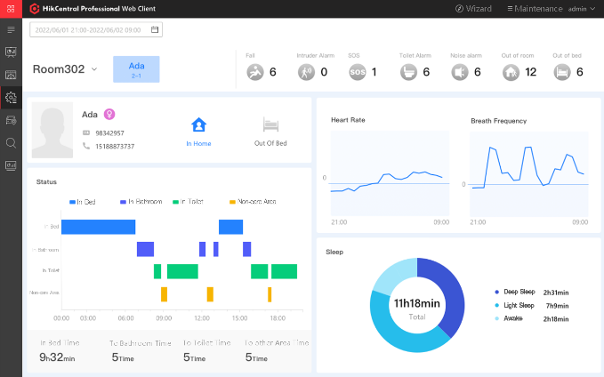






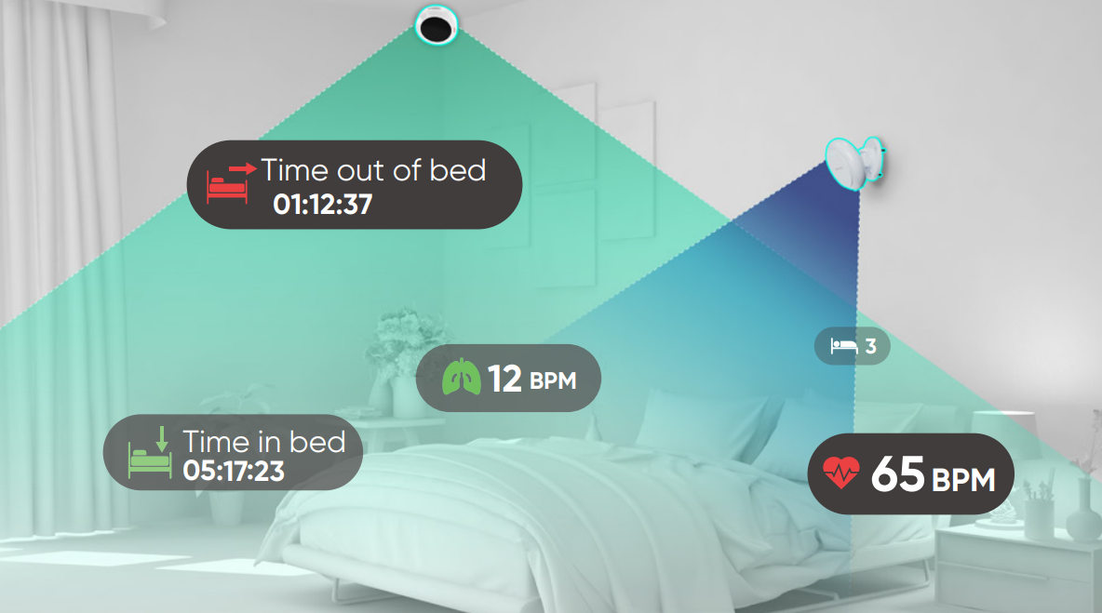
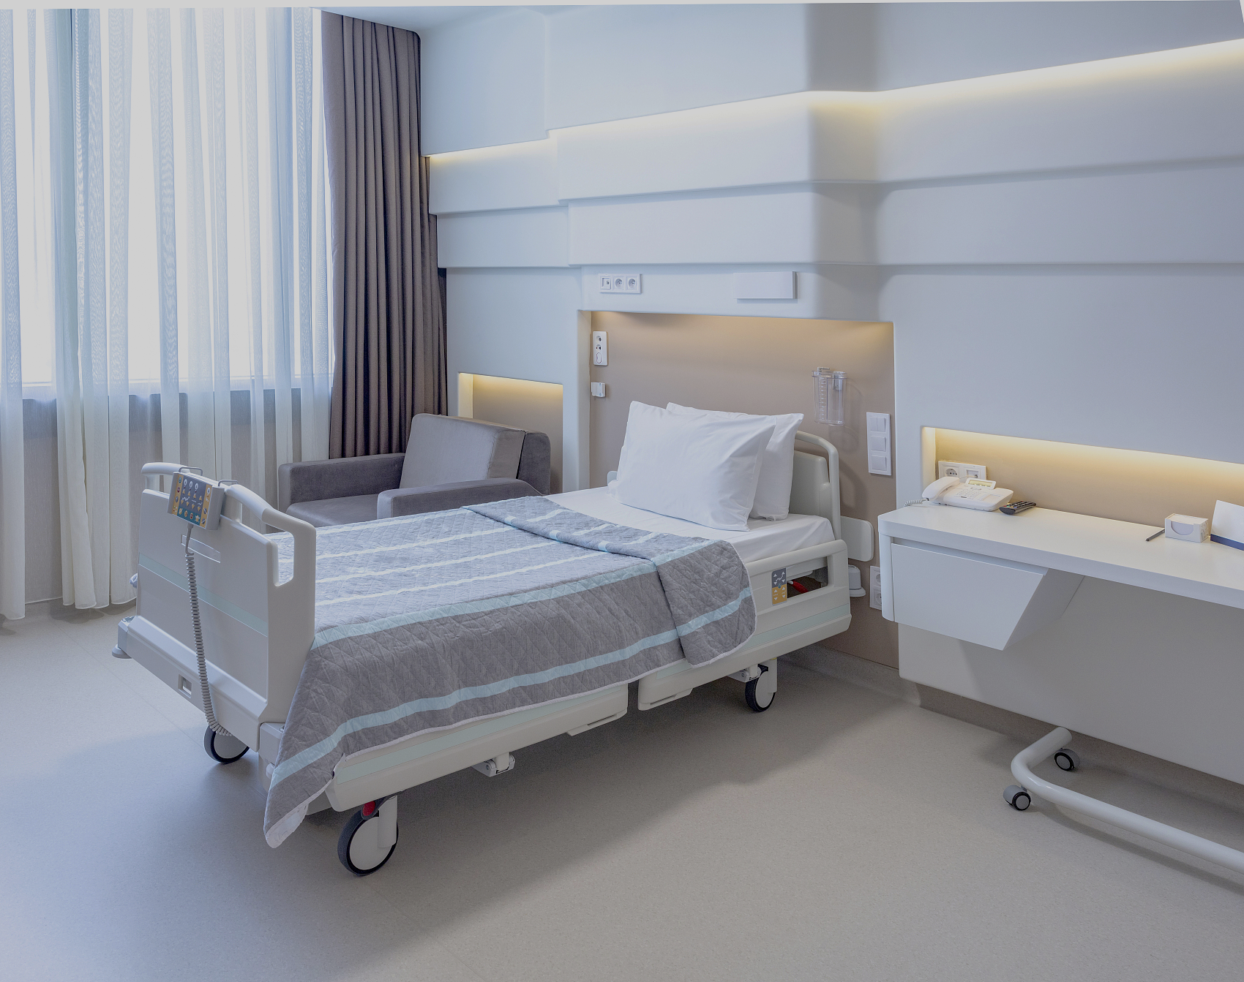
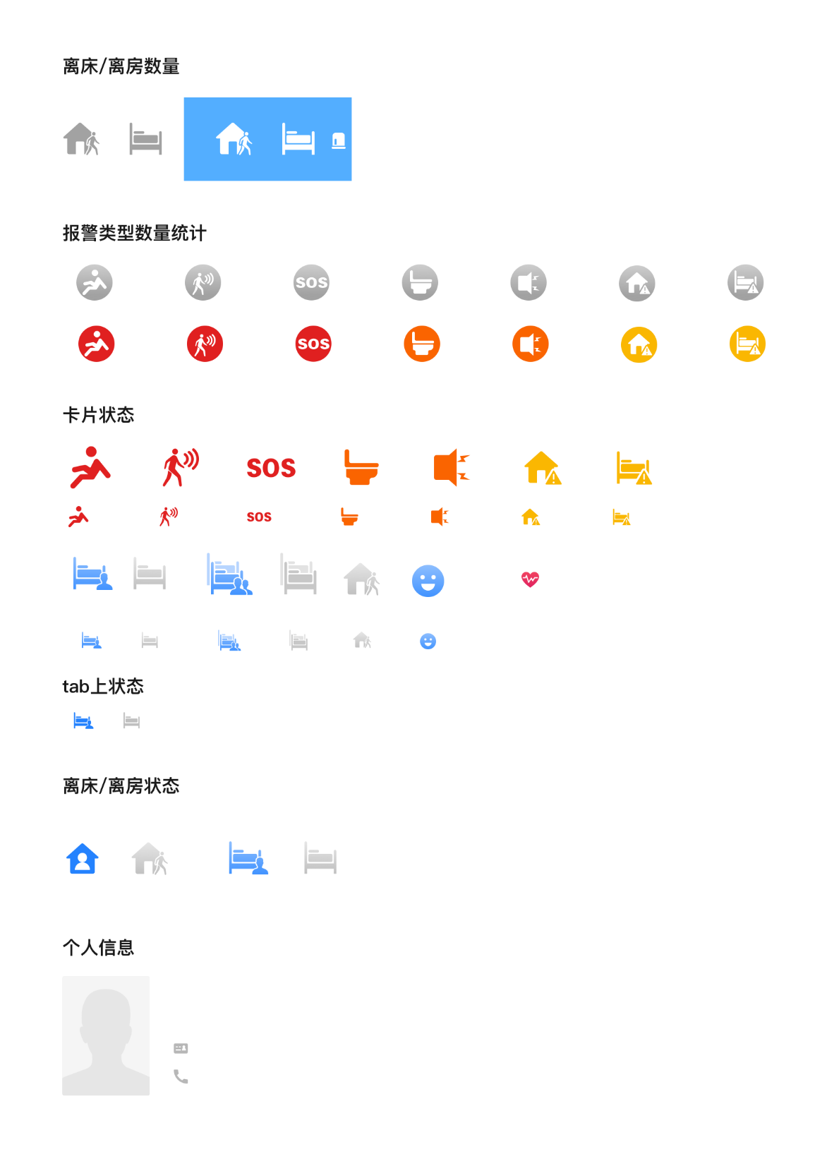
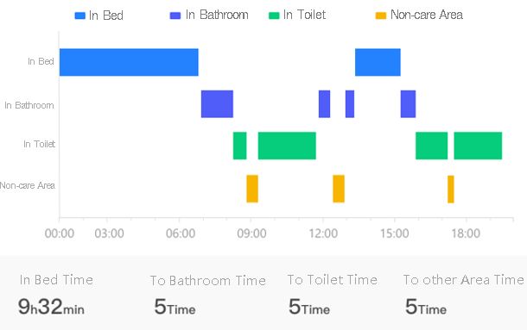

Intelligent Healthcare
Auxiliary Care Radar Sensors provide significant medical information for better analysis of sleep quality and overall health.
Thermal Presence Detectors detect if the patient is in room or not.
Non-Contact
No Privacy Disclosure
Anomaly Alarm
Discreet and Easy to Install
Self-developed sign radar (side mounted)
Thermal Presence Detector
In Bed State
Room Activity Statistics
Auxiliary Care Radar
In Bed
Out of Bed
1m
In Room State
In Room
Out of Room
Notes:
The product is focus on these three features, but not the data collection of the vital signs.
So let’s see our solutions:
We provide auxiliary care radar, which can record our main medical information to analyze sleep quality and body health.
-------
This product mainly collect the three following data:
First: it will send leaving bed alarm, for example,
when u leave bed in the middle of the night
Go to the toilet too long
Not getting up in the morning
Secondly, when u sleep in the bed, it will record the vital signs, including Heart Rate & Breath Rate
Last , after u fall in sleep, it will also record your body movements ,and provide u sleep quality report. like, how many times u are rolling over, and getting up.

Slide 11

Auxiliary Care Radar
Key Parameter
Working Frequency | 60 to 64 GHz
Modulation Wave | FMCW
Detection Range | 0.1 to 2.7m
Data Cycle | 200 ms
Horizontal & Vertical FoV | -45° to 45°，-45° to 45°
Communication Mode | WIFI, RJ45 interface
Working Voltage | Type-C DC5V IEEE 802.3af POE
Working Electric Current | ≤700mA
Weight | 170 g
High measurement accuracy
Heart rate deviation within ±5bpm
Breath rate deviation within ±2 bpm
The accuracy rate is over 90%
DS-TDSB00-EKH/POE/2M
No effect on human body
Using millimeter wave radar, and the radiated power is below 10dbm, which is smaller than mobile phones
Tips
1.Heart attack can’t be detected, if there is chest pain, chest tightness and other physical discomfort, please call emergency services.
2.Different positions will affect accuracy (back and lying positions are more accurate, side position will be slightly affect).
3. The iron bed may have an impact on accuracy.
Notes:
This part is about the parameters of Auxiliary Care Radar:
It has High measurement accuracy
And No effect on human body
Then , we have some tips u should notice.
First and the most important is that Heart attack can’t be detected, if there is chest pain, chest tightness and other physical discomfort, please call emergency services.
2.Different positions will affect accuracy (back and lying positions are more accurate, side position will be slightly affect).
3.Using iron beds will not detect the data.
3.Please avoid using iron beds, which will produce electromagnetic shielding.

Slide 12
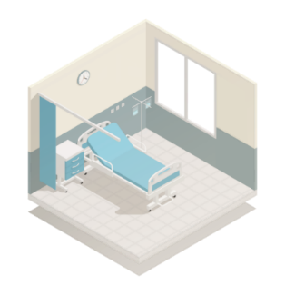
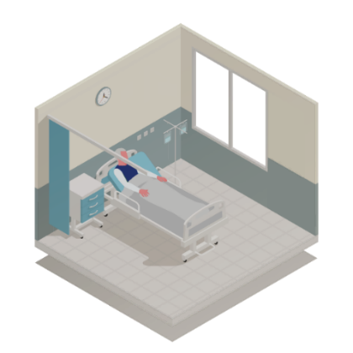





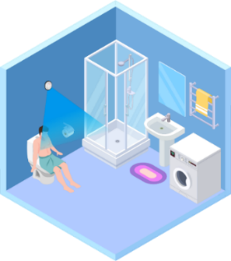
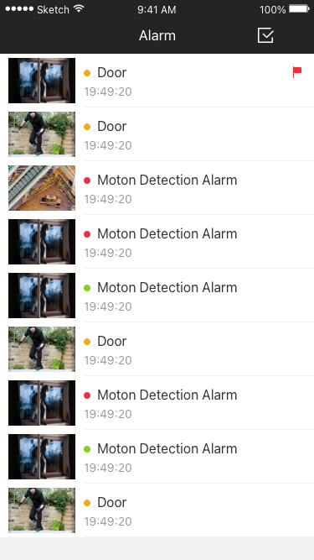

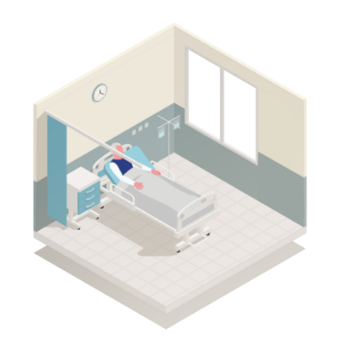

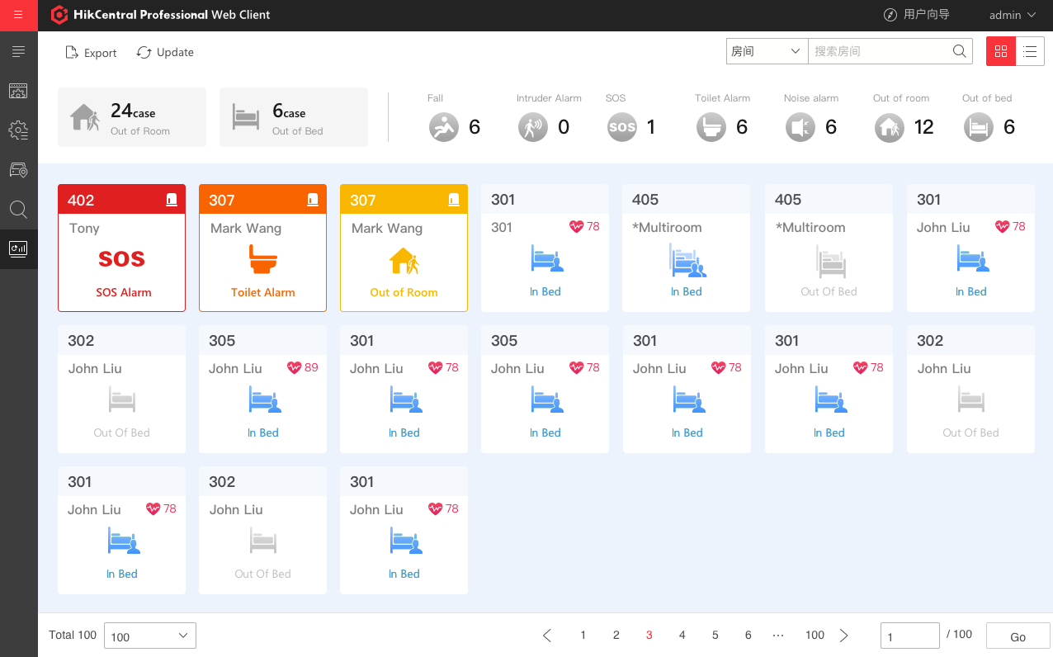





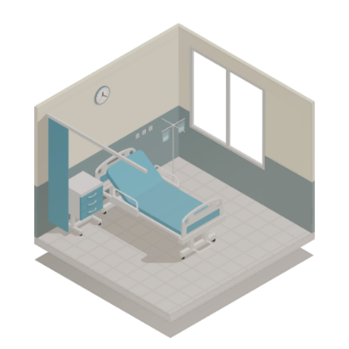




Intelligent Healthcare –Anomaly Warning
Automatic warning of abnormal status
Seven unique alarms with radar sensors and presence detectors
Unified management and configuration of radar sensors through a web interface
Visual charts to help improve
Management efficiency
Fall Detection Radar
Thermal Presence Detector
Fall Alarm
Intrusion Alarm
Automatic fall detection
Prevents intrusions and other security events at night
Overstay Alarm
Triggers alarm when patient remains in bathroom for an extended period
Noise Alarm
Detects screaming, shouting, and other noises
Auxiliary Care Radar
Vital Sign Alarm
Triggers alarm when the vital sign is higher or lower then preset value
Out-of-Bed Alarm
Out-of-Room Alarm
Prevents infant abductions
Triggers alarm when patient is out of bed for an extended period
Triggers alarm when room vacant at night for an extended period
HCP Web Interface
Notes:
能够提供7大报警类型：
1、跌倒报警
2、滞留报警：患者在卫生间/浴室停留过久（超过设定时间），则发出报警；例如昏迷、瘫倒、无法动弹等情况
3、离床报警：患者在夜间（可设定时间段），离开床超过一定时间没有返回，则发出报警，能够第一时间发现意外，也能提高巡房效率；
4、入侵报警：夜间情况有人异常闯入病房
5、体征异常报警
6、声音异常报警：监测尖叫、呼喊等情况
7、离房报警：患者夜间离开房间一定时间内没有回来，第一时间发现并且上报。

Slide 13
HealthCare Platform
Room Overview
Overview of all alarms
Easy to view the elderly status
Notes:
New homepage of healthcare platform.
The upper part is the Summary of all kinds of alarms: the staff can easily view the elderly status;
Another part is List of vital indicators, we can know Whether in the room/bed, and Heart & Breath rate.

Slide 14
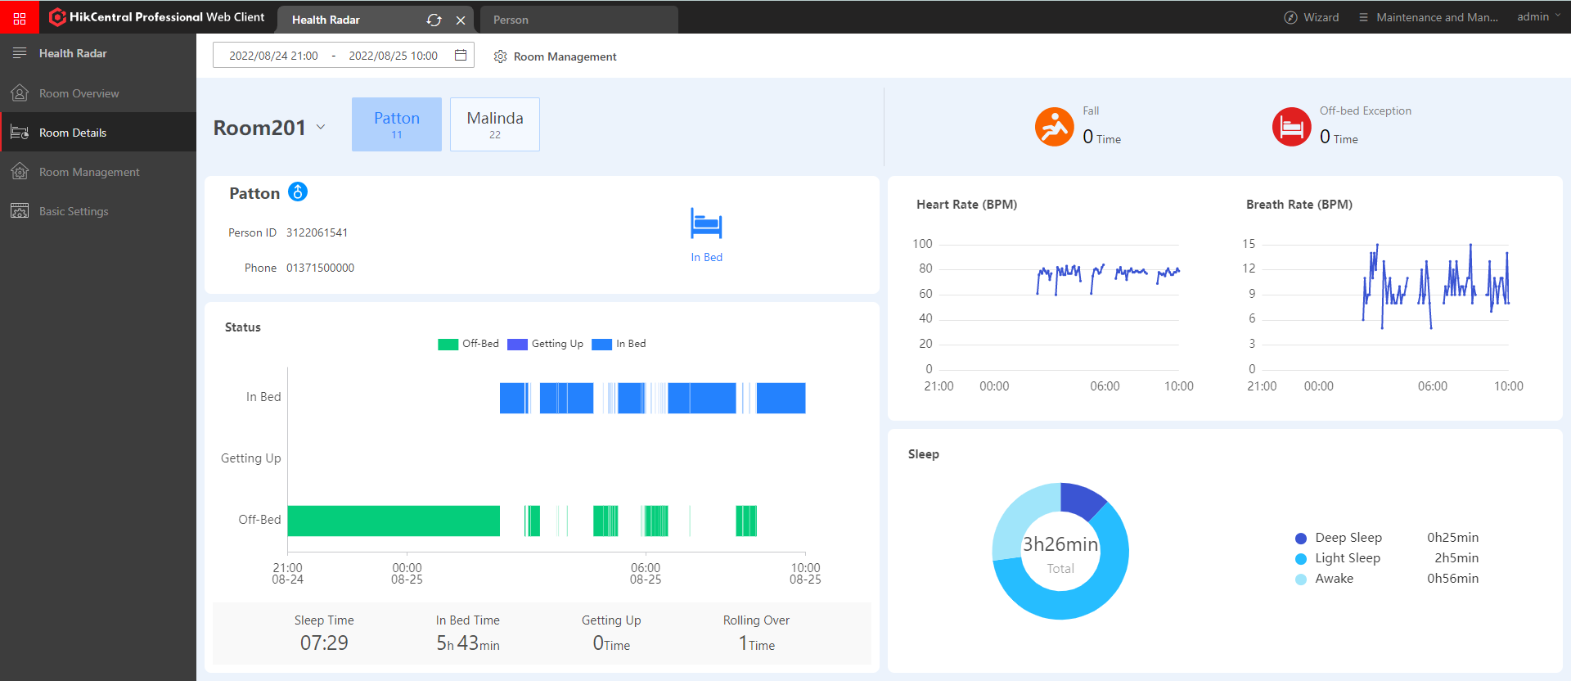
HealthCare Platform
Room Details
Show room overview
Suitable for single/multiple rooms
Displays various types of warning messages
vital signs
Heart Rate & Breath Rate
Sleep Quality Monitoring
Analysis of sleep quality
Movement Detection
In the bed/Out of Bed
Rolling Over/Getting Up
Notes:
These information are from the room perspective, first is the room overview, it support multiple people room, and kinds of alarm.
U can select anyone, and it will display their Movement Detection, vital signs, and Sleep Quality Monitoring.

Slide 15




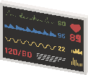


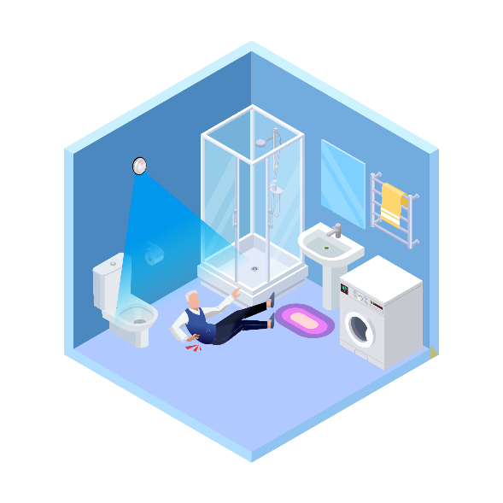
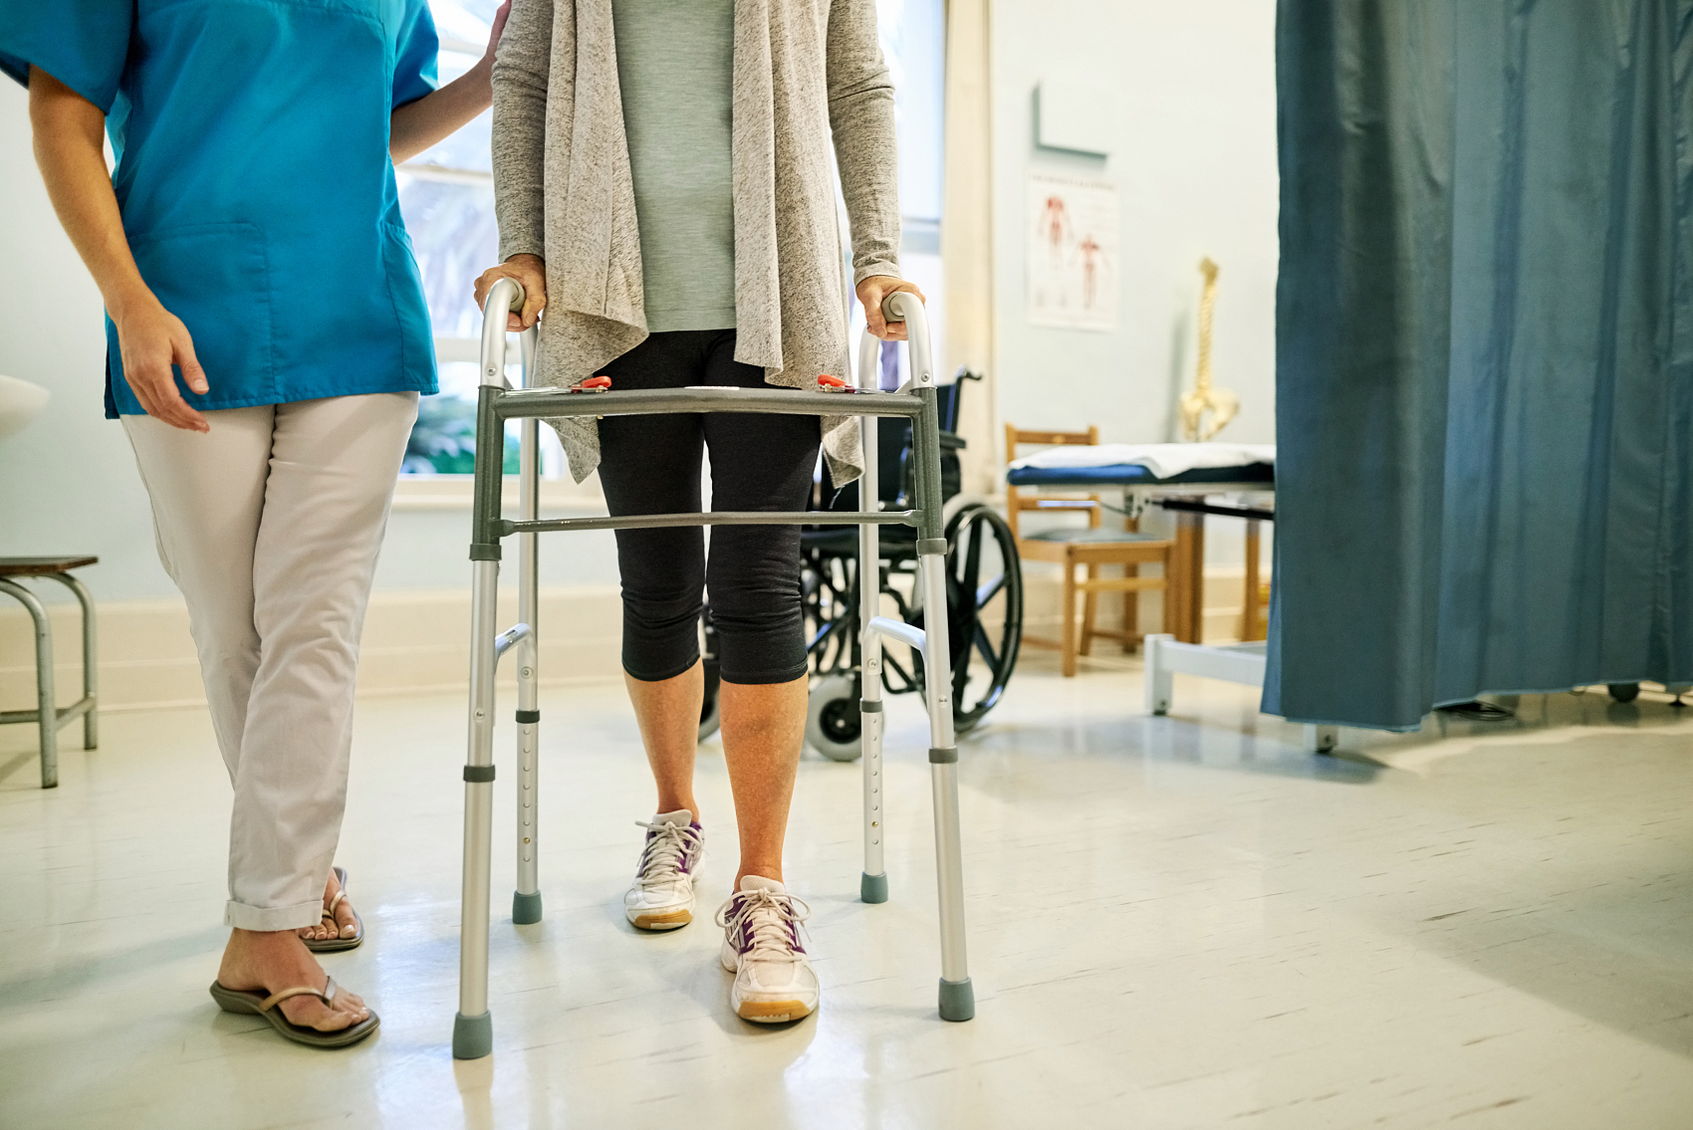


Application Scenarios
Home-based Care
Auxiliary Care
Radar
Family members can receive abnormal alarm in time and check the health status of the elder.
Fall Detection Radar
Rehabilitation Center
Detecting falls and the patient's sleep condition.
Nursing Home
Baby care Center
Nurses or doctors will be informed in time if there is any abnormal situation.
Detecting postpartum mothers` and babies daily activities sleep condition to avoid accidents and help with quick recovery.
Notes:
Let’s see what the application scenarios.
Of Couse, the nursing home is our main scenario.
We can also apply in these three places:
The home based care, Rebilitation Center, Baby care Center

Slide 16
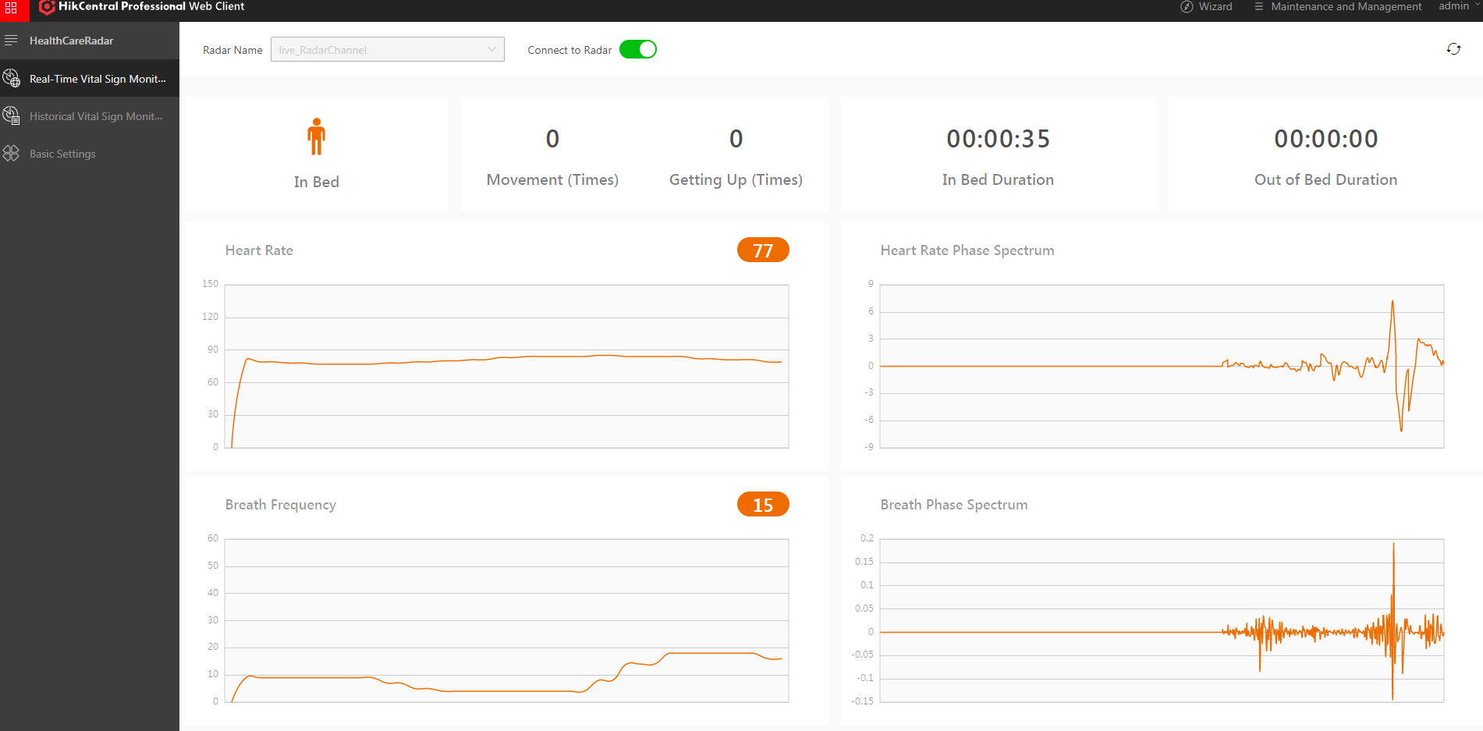



System Topology
Timely Response
Basic Vital Signs Reports
Timely Response and Service SOP Flow
Detailed Health Repots
Vital Signs Repots
Sleep Reports
Health Reports
…
Alert Mechanism
PC Alarm
APP Alarm
PC Alarm
APP Alarm
Medical Workers
Care Service
HikCentral Professional
Existing 3rd Party Care Service Platform
Local radar and cameras device management
Building & campus video surveillance system management
System integration interface
Falls alert management and care service SOP management
Deep health reports analysis such as sleep report display
Other applications if needed from Hikvision systems
Home/Personal Space
Basic data detection to solve indoor emergencies
Fall Detection Radar
Auxiliary care Radar
Thermal Presence Detector
Notes:
This is our topology:
As we can see, The Fall Detection Radar and Auxiliary care Radar can link to HCP, we can check it on PC
Client and app client , we also support OpenAPI to export our data for the 3rd Party Platform.

Slide 17
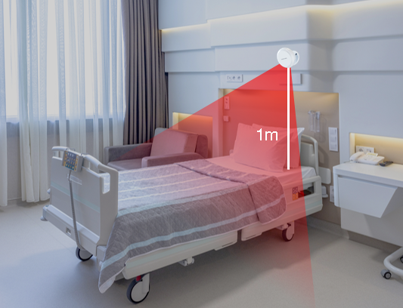


Deployment
Radar Position
2m
4m
2.4m
Fall Detection Radar(Self-developed)
Auxiliary Care Radar(Self-developed)
The radar needs to be installed at a height of 2m and the detection area is centered horizontally. The detection area supports a maximum of 4 x 2.4m.
Install the radar against the wall, ensure that the front of the radar panel is tilted down by 45°.
Use tools to fix the radar on the ceiling, make the radar to bed height 1m, and the maximum detection range of the bed is 2*2m
The radar is aimed at the upper body, and ensure the arrow on the radar points to the foot of the bed.
Notes:
This is the deployment instruction about our two products.
For the Fall Detection Radar, it needs to be installed against the wall, the detection area supports a maximum of 4 multiply 2.4 meters.
For the Auxiliary Care Rader, please use tools to fix the radar on the wall, make the height between radar and bed in 1 meters.
For more details, I will upload the deployment document to MPS after the Live and you can check it.

Slide 18
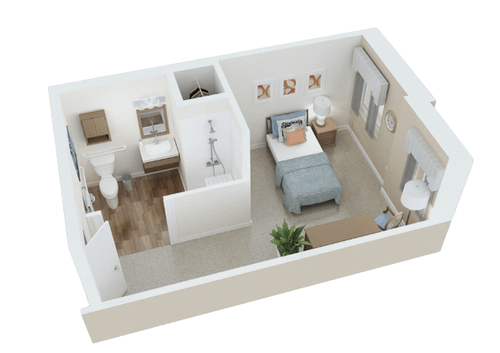
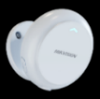


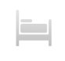




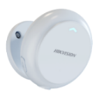











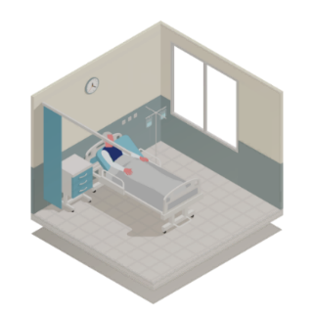


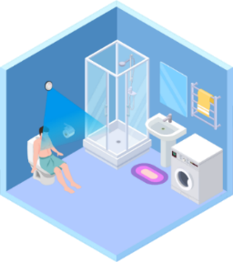



Healthcare Management
Provide comprehensive health care for the elderly
Functions
Software
Auxiliary Care Radar
Vital Signs
In Bed State
Heart Rate
Respiration
In Bed
Out of Bed
Fall Detection Radar
Fall Detection
Overstay
In Bathroom
Thermal Presence Detector
Video Check
In Room State
Non-visible
In Room
Out of Room
Seven Alarms
Fall Alarm
Overstay Alarm
Intrusion Alarm
Noise Alarm
Vital Sign Alarm
Out-of-Room Alarm
Out-of-Bed Alarm
Help!
Notes:
Overview

Slide 19
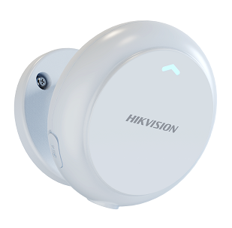
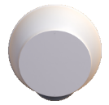
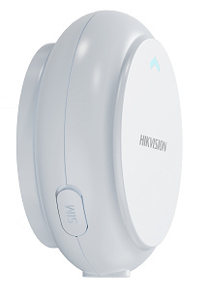
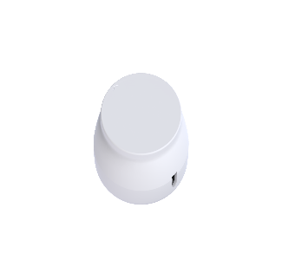
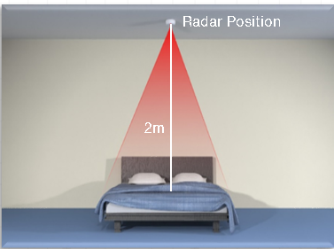
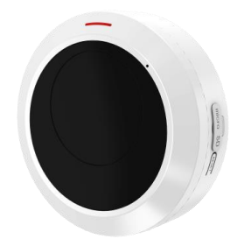
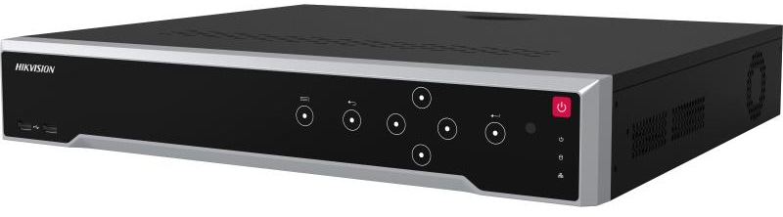
BoQ
Device | Product Name | Code | Picture | No.
Fall Detection Radar | DS-TDSB00-EKT/POE/4m | 314400141 |  | Self-developed Support POE； Web configuration；
 | DS-TDSB00-EKT/4m(O-STD) | 302102473
Auxiliary Care Radar | DS-TDSB00-EKH/POE/2m | 314400140 |  | Self-developed Support POE； Web configuration； Side wall installation (1m from bed height)
 | DS-TDSB00-EKH/2m(O-STD) | 302102471 |  | Top loading (2m from the bed)
Thermal Presence Detector | HM-TD1017-2/QW-HS121(O-STD) | 305401641
 | DS-7716NI-I4(B)(STD) | 303607718 |  | Optional (custom function)
HCP License | HikCentral-P-HealthCareRadar-1Unit | 401000514 |  | Depends on project size
 | HikCentral-P-HealthCareThermal-1Unit | 401000635 |  | Depends on project size
 | HikCentral-P-VSS-Base/0Ch | 401000147 |  | 1
Note：HCP HealthCare Version is a customized version based on HCP 2.2.2 baseline
Notes:
You need to buy a VSS Base package to unlock the healthcare module
The current version is based on HCP customized 2.2.2
The next version is HCP customized 2.2 and will released by the end of July

Slide 20


