Slide 1
HCP
Smart Hospital Solution
Delivery Solution

Slide 2


P.01
Device Configuration

Slide 3



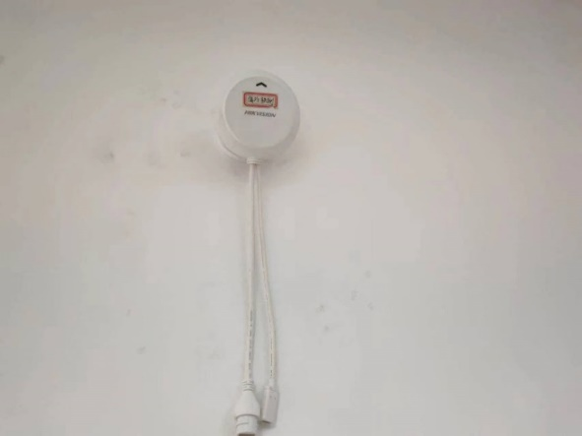
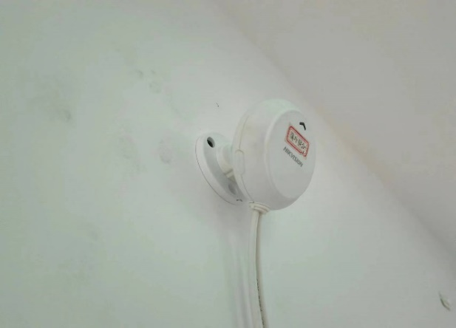
Installation & Deployment
Device Installation for Fall Detection Radar
Installation Environment
The device must be installed on a wall at a height of 2 m.
1.Avoid installing on the doors, door frames or other moving objects.
2.Do not install it in places with obvious shielding, such as doors, bookshelves, shower curtains in order to avoid affecting the detection effect.
3.Avoid facing the device directly against the wall.
4.Do not cover any objects on the device to avoid affecting the detection effect.
5.The device is mainly used for single-person detection, and the detection effect may be affected when there are multiple people.

Slide 4
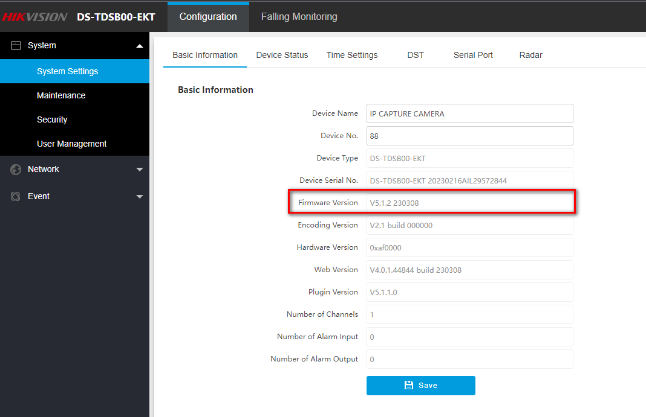
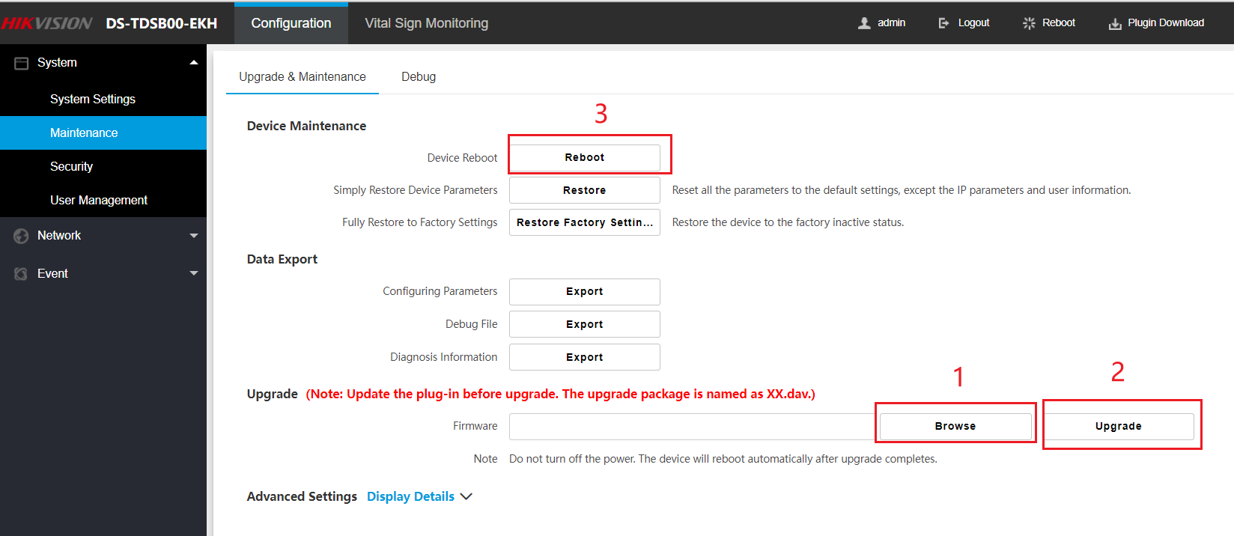
Installation & Deployment
Device Configuration
Activation：
We can activate the Radar by SADP like other Hikvision Device
Activate via Web Browser：
Default IP address: 192.168.1.64
Default user name: admin
Upgrade Firmware
1. Go to Configuration > Maintenance.
2. Choose Firmware.
3. Click Upgrade.
4. Reboot the device.
International Resource Platform/02 Solutions/01 Solutions by Industry/01 EBG Solutions/SmartHospital SBI/03 Deployment Material/01 Firmware

Slide 5
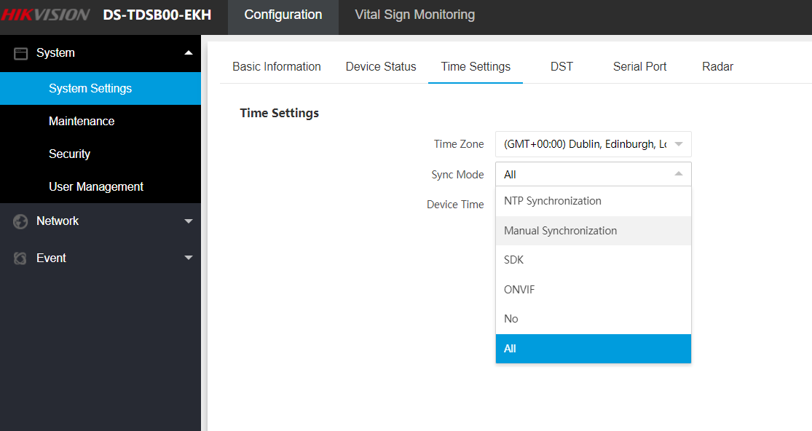
Installation & Deployment
Device Configuration
Configure the time zone
1. Go to Configuration → System → System Settings → Time Settings.
2. Select Time Zone.
3. Select Sync Mode.

Slide 6
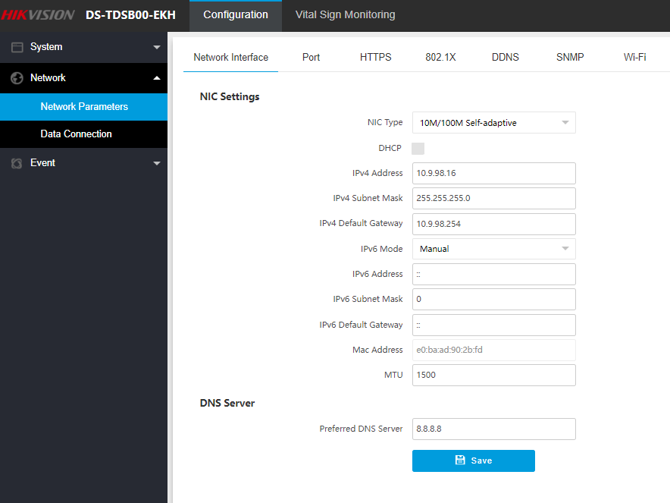
Installation & Deployment
Device Configuration
Configure network parameters（for cable connect）
1. Go to Configuration → Network → Network Parameters → Network Interface。
2. Set IP address
3. Click Save

Slide 7
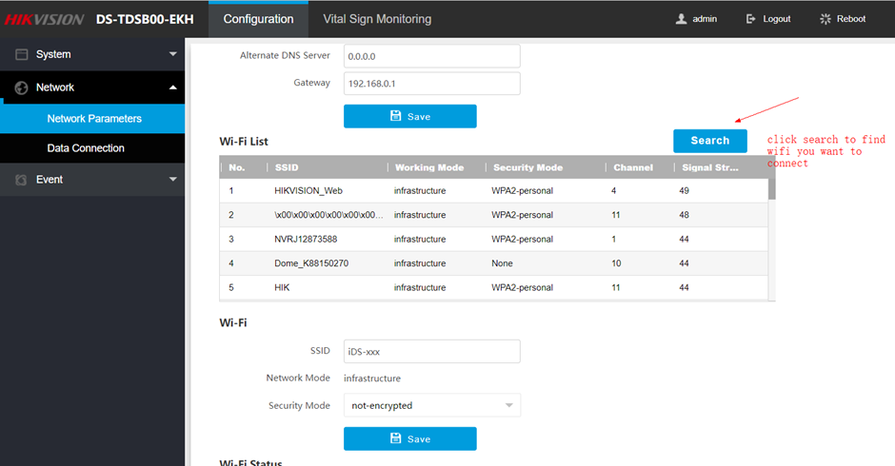
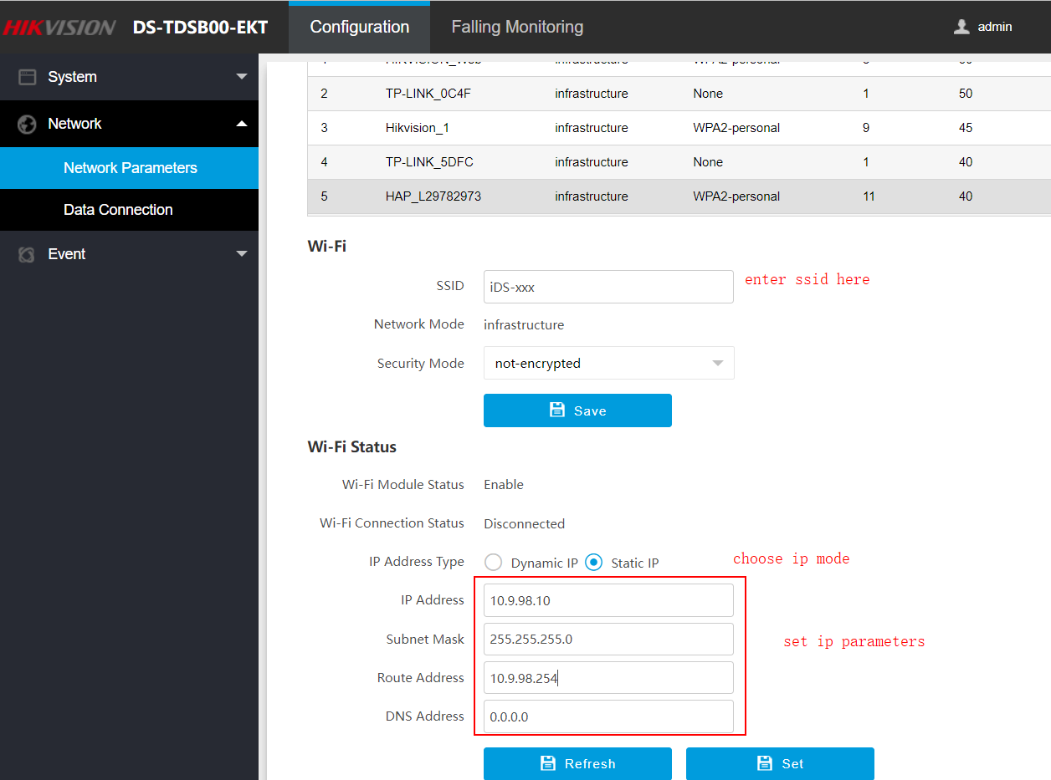
Installation & Deployment
Device Configuration
Configure wifi parameters(for wifi connect)
Set Wi-Fi parameters if you want to connect the device to the network via Wi-Fi.Steps:
1. Go to Configuration → Network → Network Parameters → Wi-Fi.
2. Select Wi-Fi Mode as Wi-Fi.
3. Click Search and select Wi-Fi to connect in the Wi-Fi list.
4. Select Security Mode and Encryption Type according to the actual needs.
5. Enter Key.
6. Click Save.

Slide 8
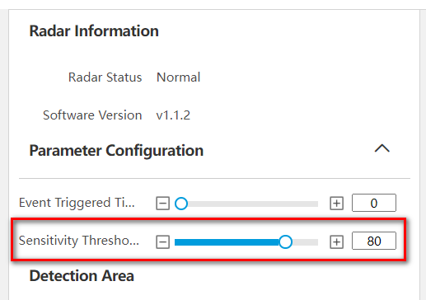
Installation & Deployment
Device Configuration
Set Detection Parameters
Set the Sensitivity Threshold of Human Body Detection as 80

Slide 9
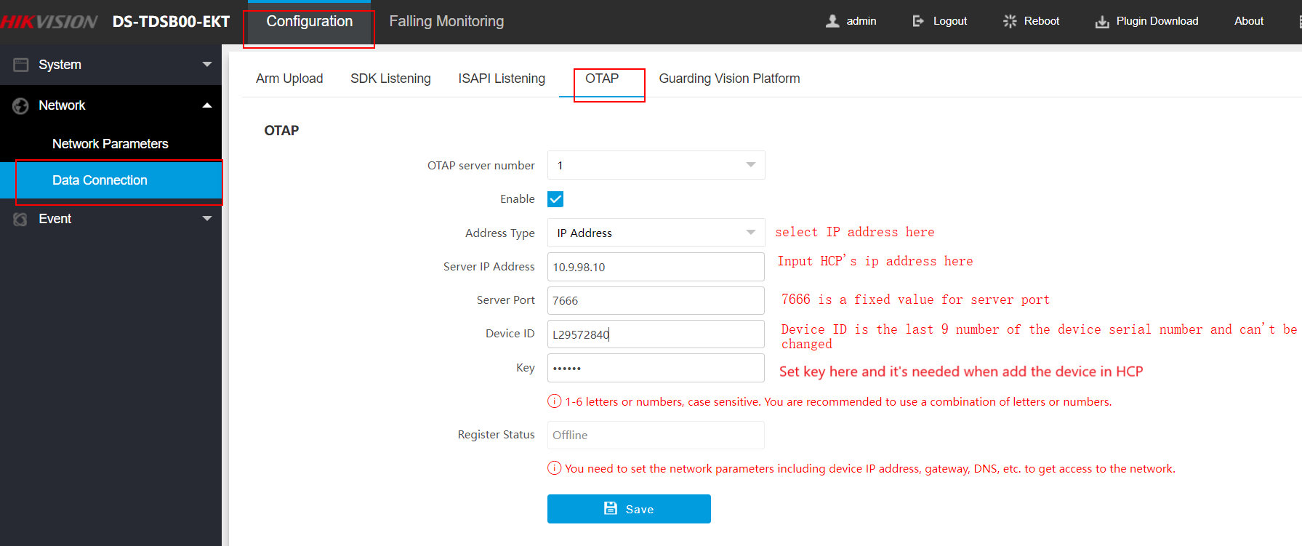
Installation & Deployment
Device Configuration
Set OTAP

Slide 10
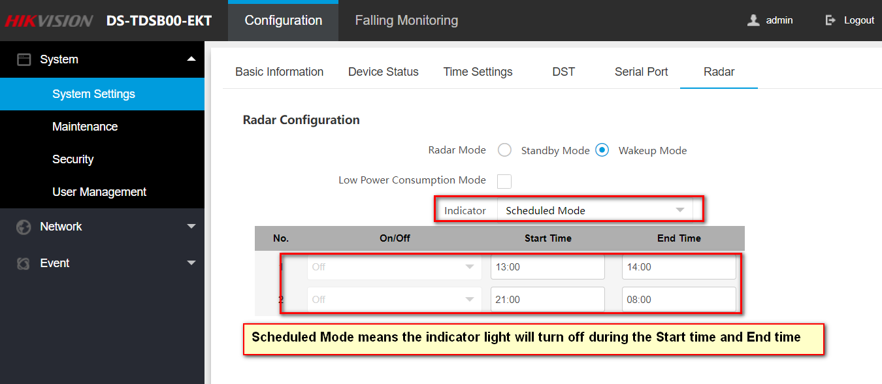
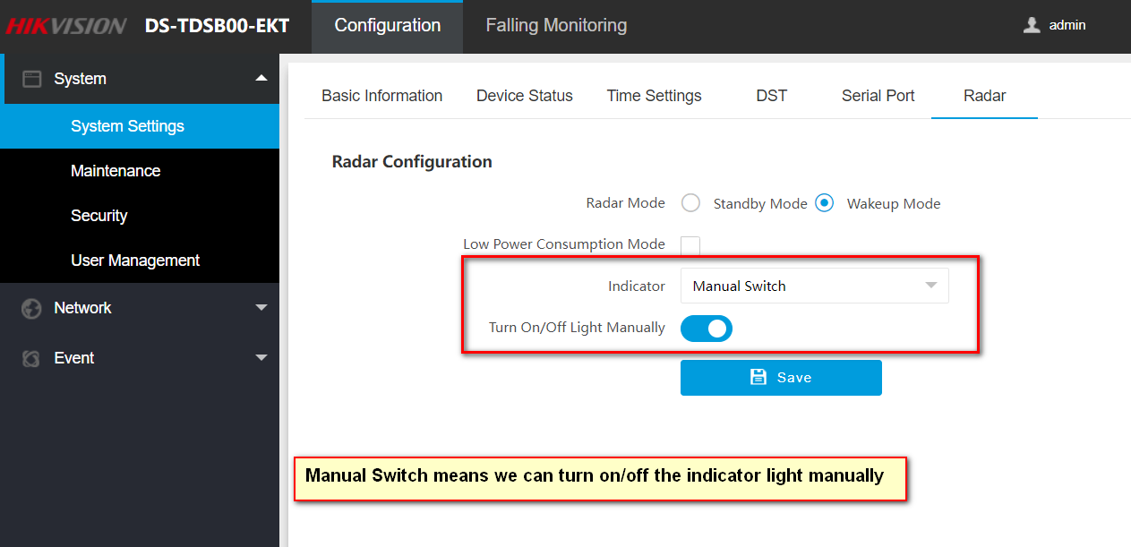
Installation & Deployment
Device Configuration
Indicator light set

Slide 11
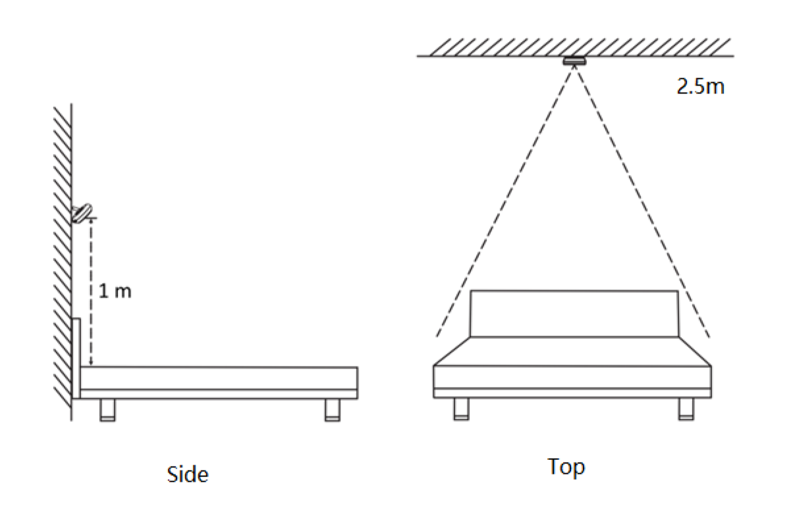

Installation & Deployment
Device Installation for Auxiliary Care Radar
Before installation
1. The equipment supports side and top mounting, which can be installed on the wall at the head of the bed or on the roof facing the bed.
2. During side installation, the distance between the equipment and the bed surface shall be 1 m. During top installation, The distance between the equipment and the bed surface shall be 2.5m.
3. The equipment is mainly used for detection in single-person scenes. Please ensure that there is no cover between the equipment and the detection target.
Side mounting(Recommend)：
Detection more accurate
Not support Getting up detection
Top Mounting:
If don’t support side mounting, need use top mounting
Support Getting up detection
recommend

Slide 12
Installation & Deployment
Device Configuration
Activation：
We can activate the Radar by SADP like other Hikvision Device
Activate via Web Browser：
Default IP address: 192.168.1.64
Default user name: admin
Upgrade Firmware
1. Go to Configuration > Maintenance.
2. Choose Firmware.
3. Click Upgrade.
4. Reboot the device.

Slide 13
Installation & Deployment
Device Configuration
Configure the time zone
1. Go to Configuration → System → System Settings → Time Settings.
2. Select Time Zone.
3. Select Sync Mode.

Slide 14
Installation & Deployment
Device Configuration
Configure network parameters（for cable connect）
1. Go to Configuration → Network → Network Parameters → Network Interface。
2. Set IP address
3. Click Save

Slide 15
Installation & Deployment
Device Configuration
Configure wifi parameters(for wifi connect)
Set Wi-Fi parameters if you want to connect the device to the network via Wi-Fi.Steps:
1. Go to Configuration → Network → Network Parameters → Wi-Fi.
2. Select Wi-Fi Mode as Wi-Fi.
3. Click Search and select Wi-Fi to connect in the Wi-Fi list.
4. Select Security Mode and Encryption Type according to the actual needs.
5. Enter Key.
6. Click Save.

Slide 16
Installation & Deployment
Device Configuration
Set OTAP

Slide 17
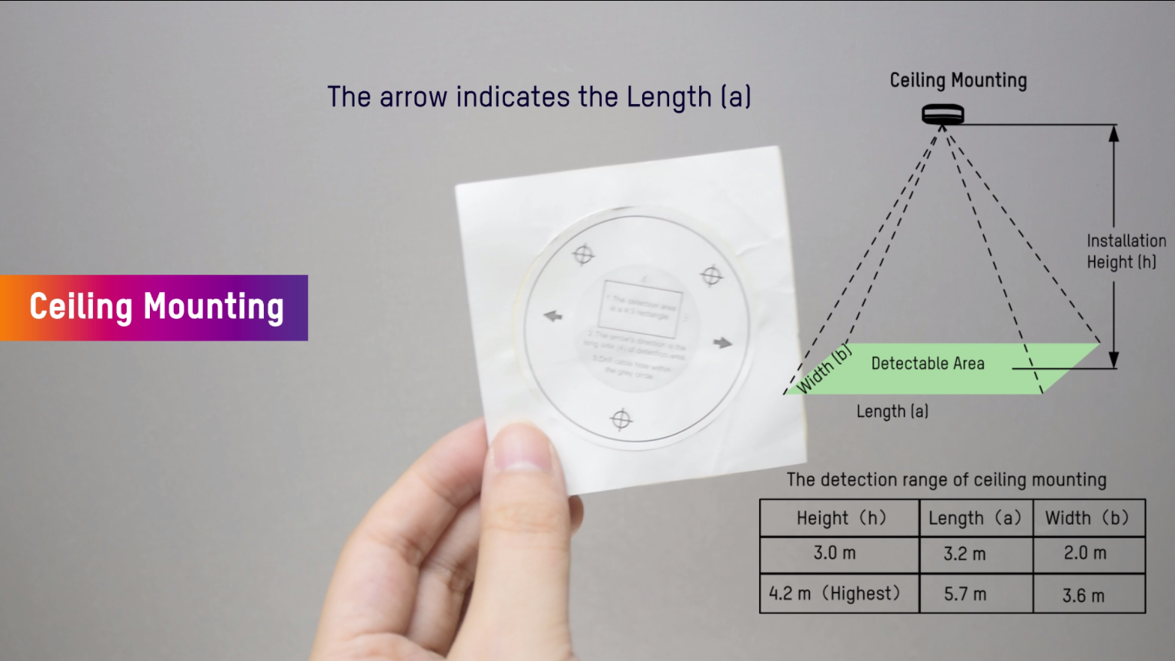
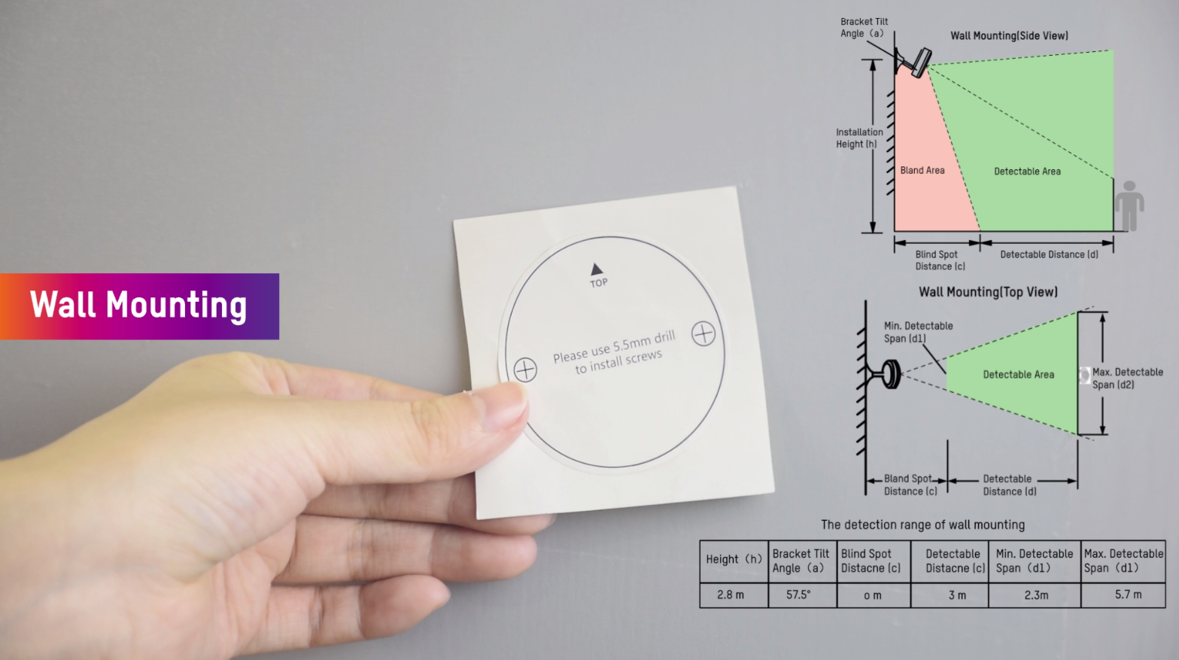
Installation & Deployment
Device Installation for Thermal Detector

Slide 18
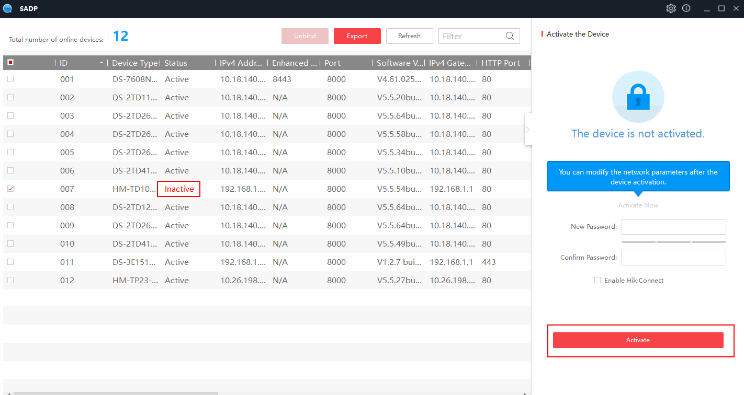
01
Installation & Deployment
c
Section 1 Device Activation and Connection-- Wired
Access https://www.hikvision.com/en/support/tools/hitools/clea8b3e4ea7da90a9/ to get SADP software to install
Connect your computer to the same network that the device is in.
Run SADP software to search and activate the online devices of the LAN.
Choose the presence detector, then enter the new password of admin, and click Activate button.

Slide 19
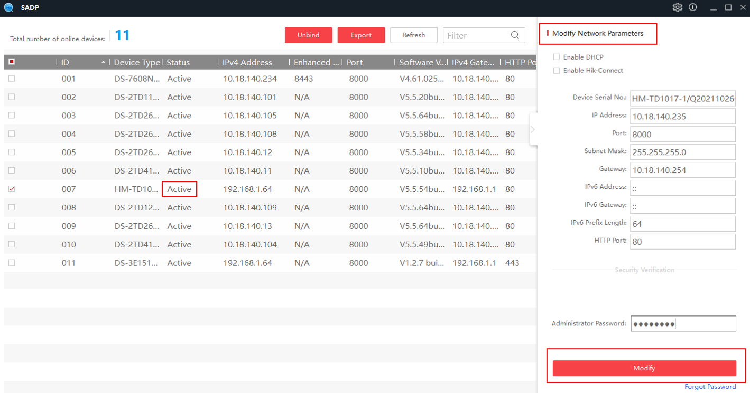
01
Installation & Deployment
Device Configuration
Section 1 Device Activation and Connection-- Wired
Connect your computer to the same network that the device is in.
Run SADP software to search and activate the online devices of the LAN.
Choose the presence detector, then enter the new password of admin, and click Activate button.
The presence detector status changes to active, then modify network parameters as required.

Slide 20
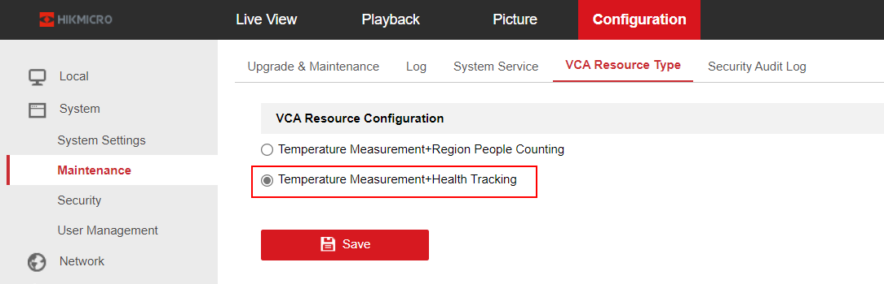
01
Installation & Deployment
Device Configuration
Section 2 Health Tracking
Preparation:
Select Health Tracking VCA Resource Type, then the device will be rebooted automatically.
Health Tracking entry can be found in the left navigation bar of the device after it is restarted.

Slide 21
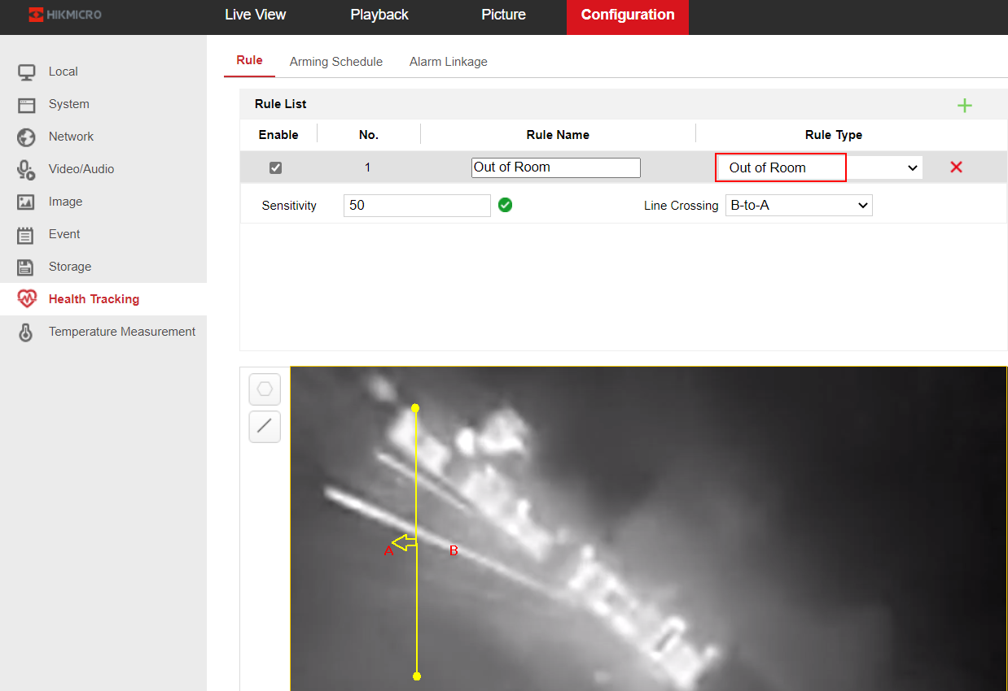
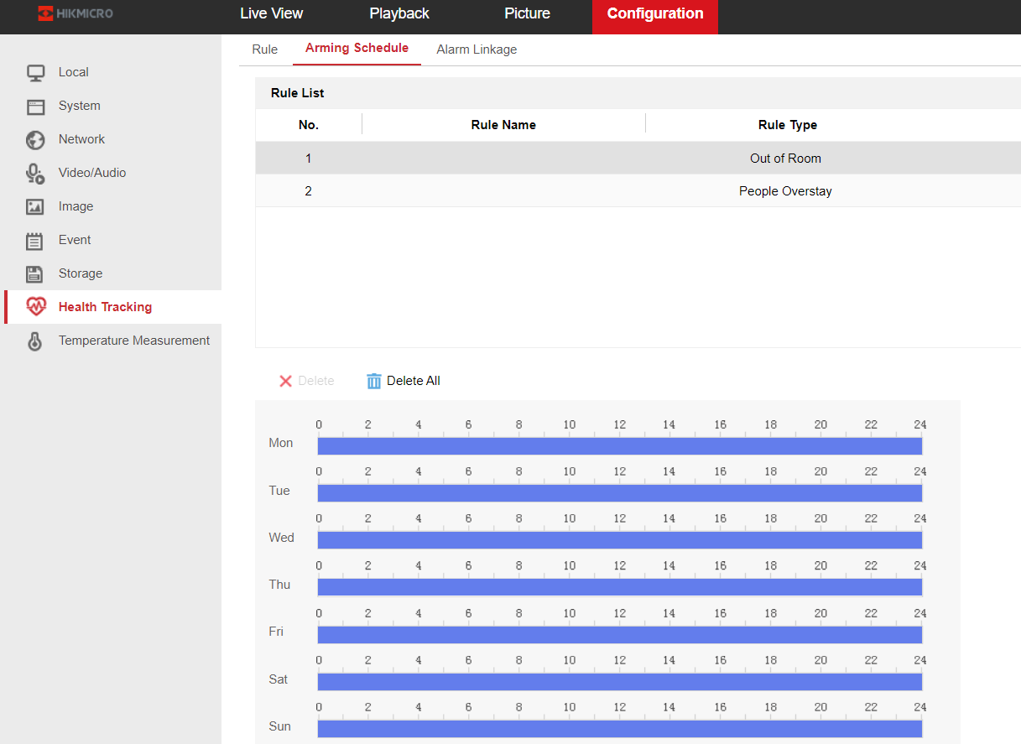
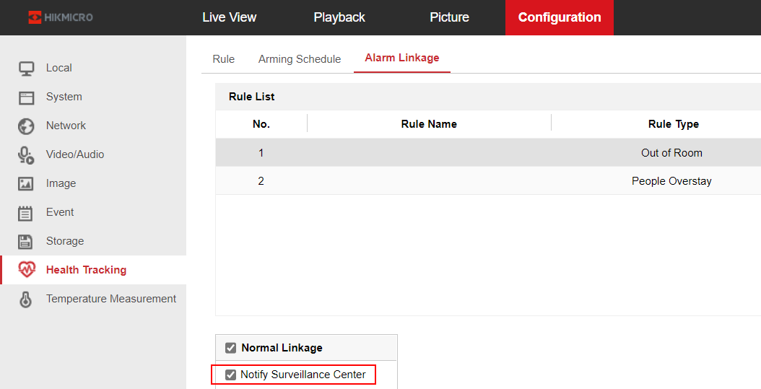
01
Installation & Deployment
Device Configuration
Section 2 Health Tracking
[Out of Room]:
Go to the Health Tracking page, and create the Out of Room rule. Draw the detection line, set from B side to A side as required. At the same time, adjust the Sensitivity value appropriately. Usually, the default 50 is suitable for most cases. The higher the sensitivity value is, the faster the alarm event is uploaded when the person leaves the room.

Slide 22
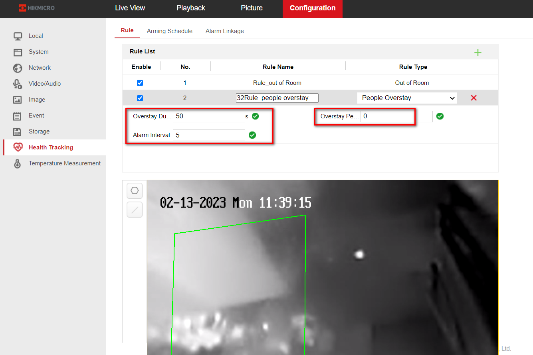
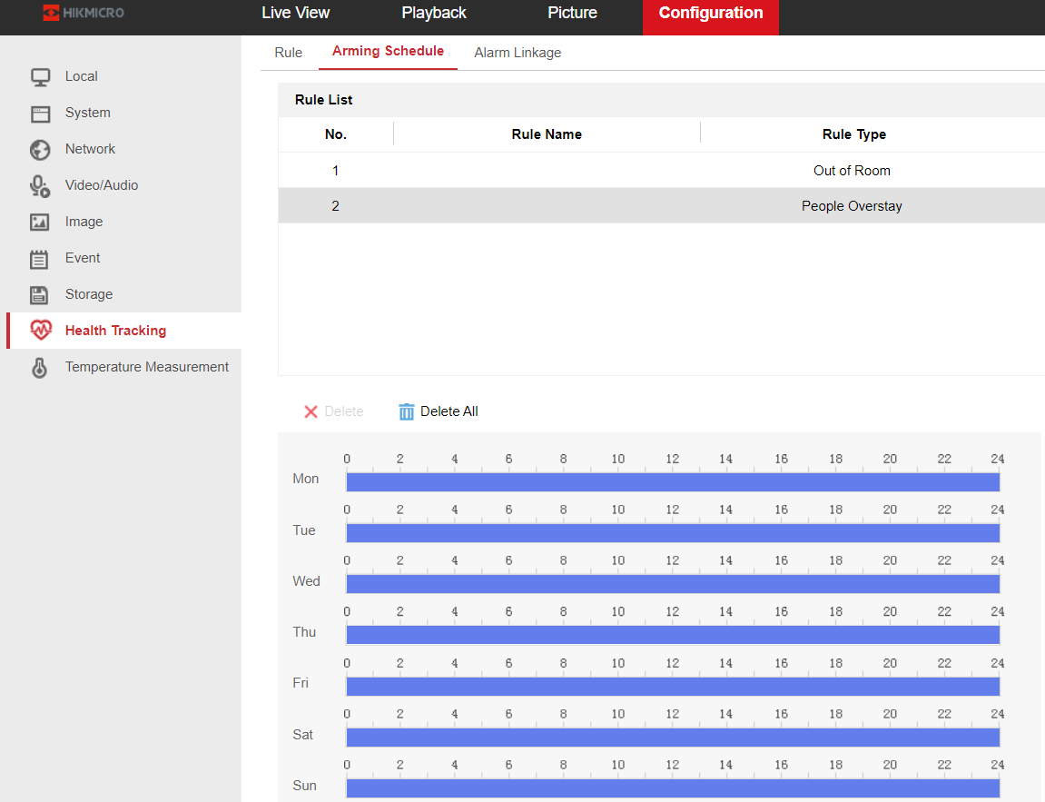
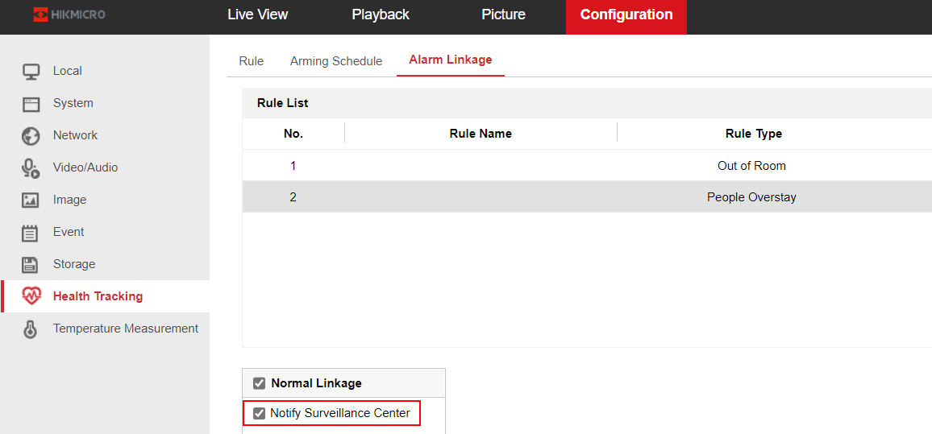
01
Installation & Deployment
Device Configuration
Section 2 Health Tracking
[People Overstay] :
Go to the Health Tracking page, and create the People Overstay rule. Draw the specific detection area， Overstay Duration 50S， Overstay People Number：0， Alarm Interval：5. It means that when more than or equal to 1 people stay in the detection area for over 50s, the first alarm begins. In addition, alarms are continuously uploaded every 5 seconds when requirements are continuously met.

Slide 23
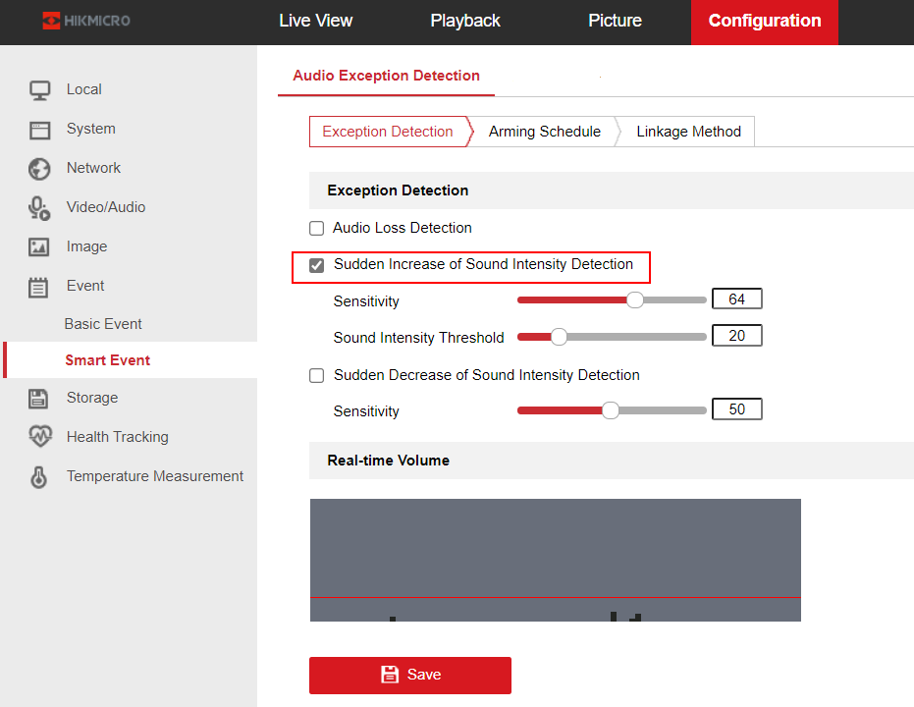
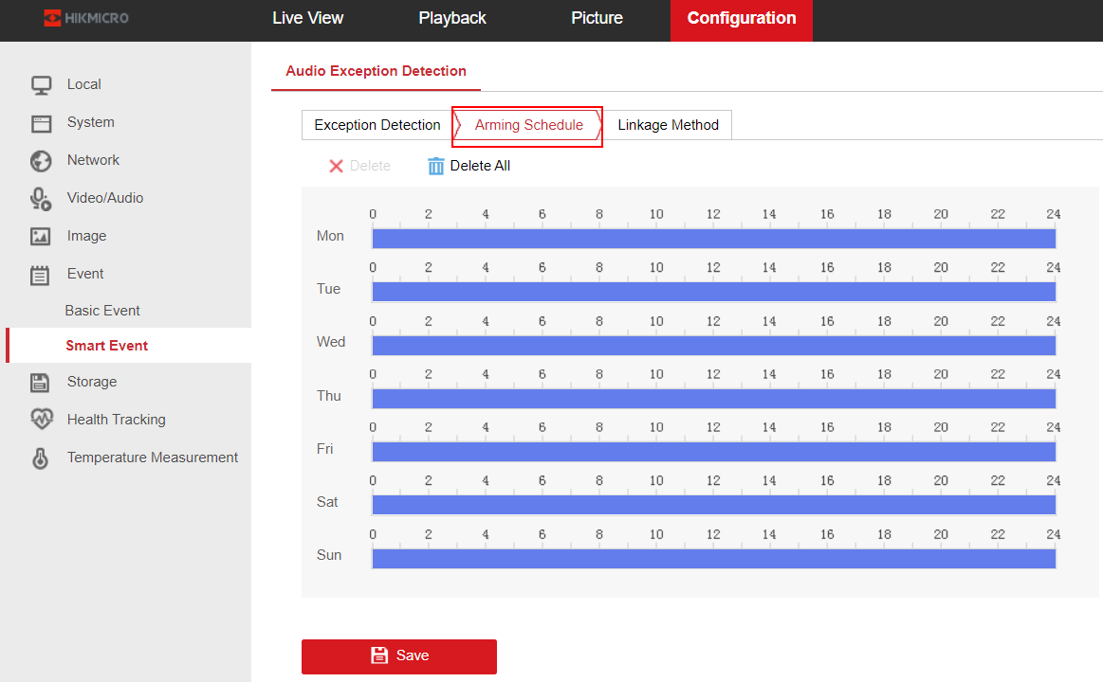
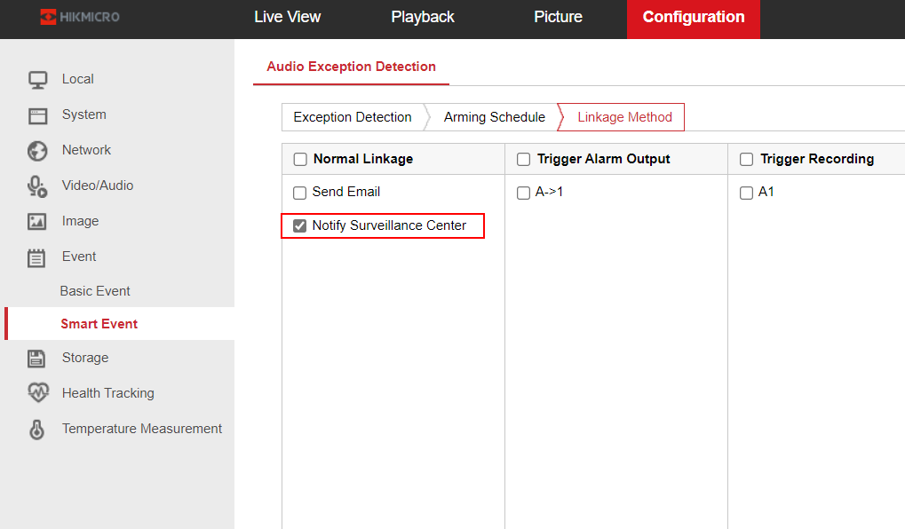
01
Installation & Deployment
Device Configuration
Section 2 Health Tracking
[Audio Exception Detection: Sudden Increase of Sound]:
Go to the Smart Event page, and check Sudden Increase of Sound Intensity Detection to detect the sound steep rise in the surveillance scene. You can set the detection sensitivity and threshold as required for sound steep rise.

Slide 24
P.02
Business & Function Configuration

Slide 25
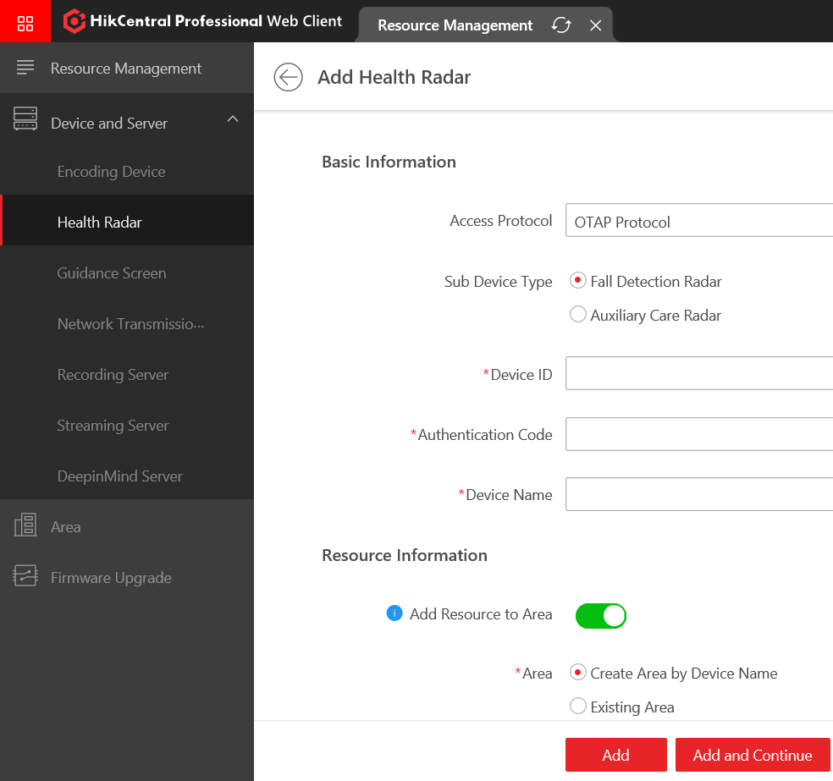
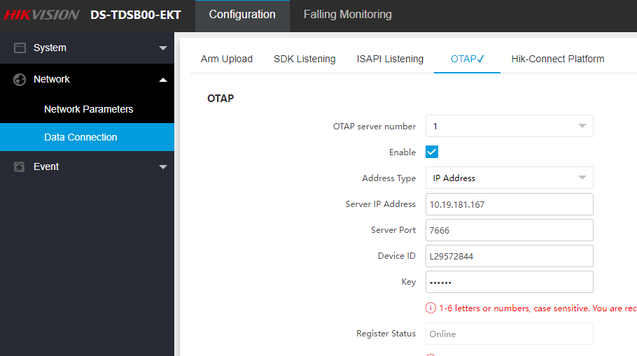
01
4.1.1 Add Radar Device
Go to General → Resource Management → Device and Server → Health Radar add the device.

Slide 26
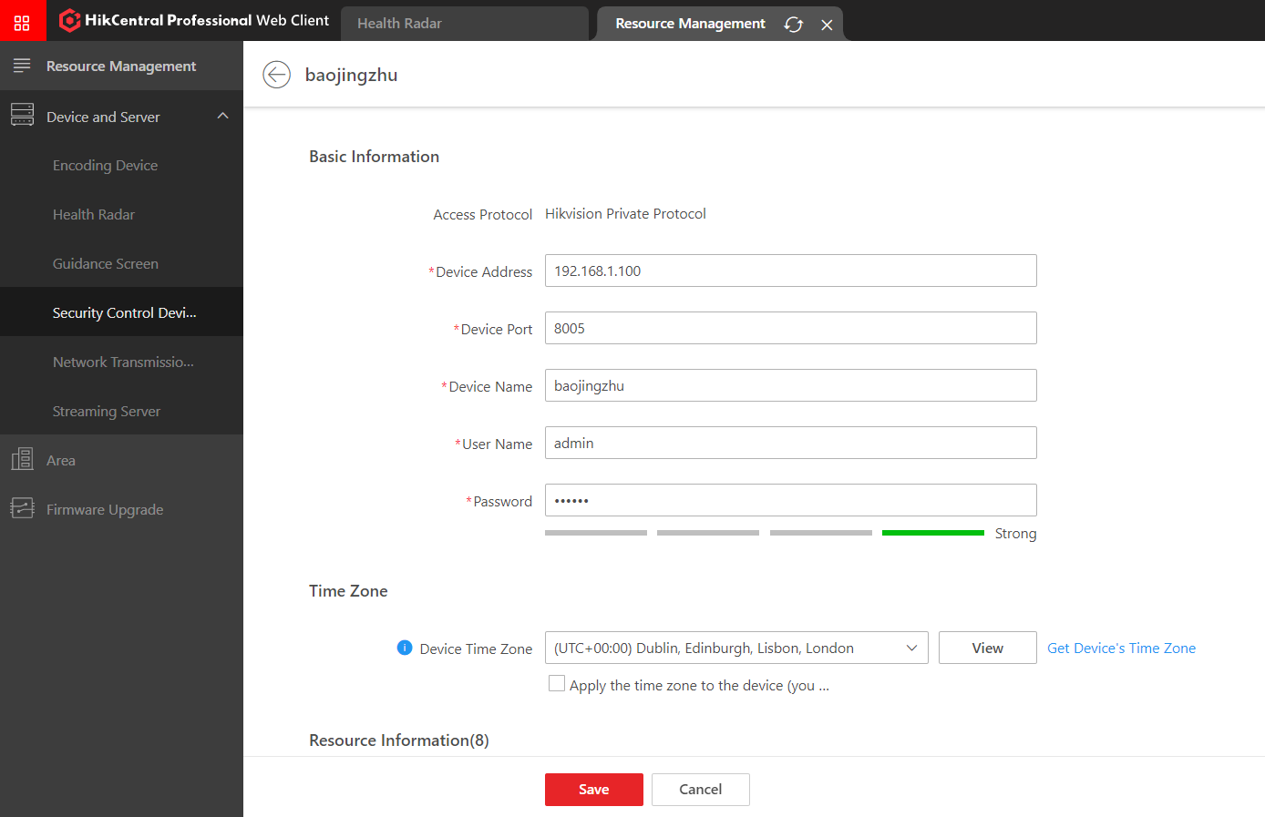
01
4.1.2 Add Security Control Device
Go to General → Resource Management → Device and Server → Security Control Device add the device.
Note: only Panic Alarm Station & Pole Panic Alarm Station need to add to the HCP. Mater Station don’t need to add to HCP

Slide 27
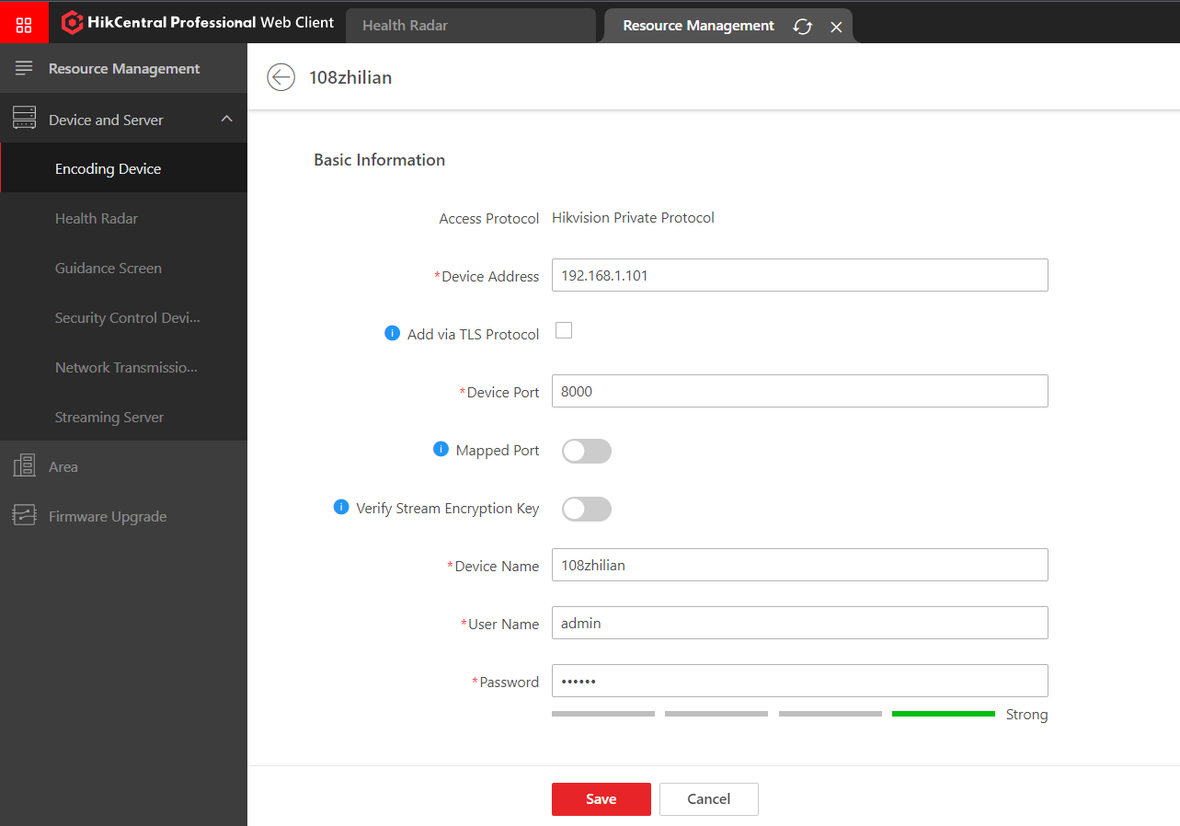
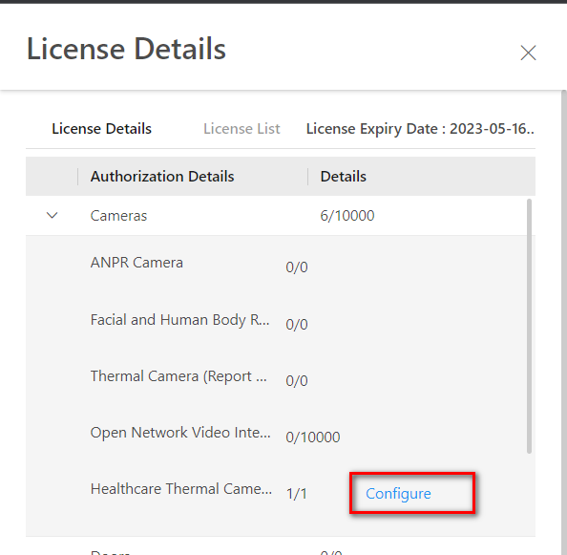
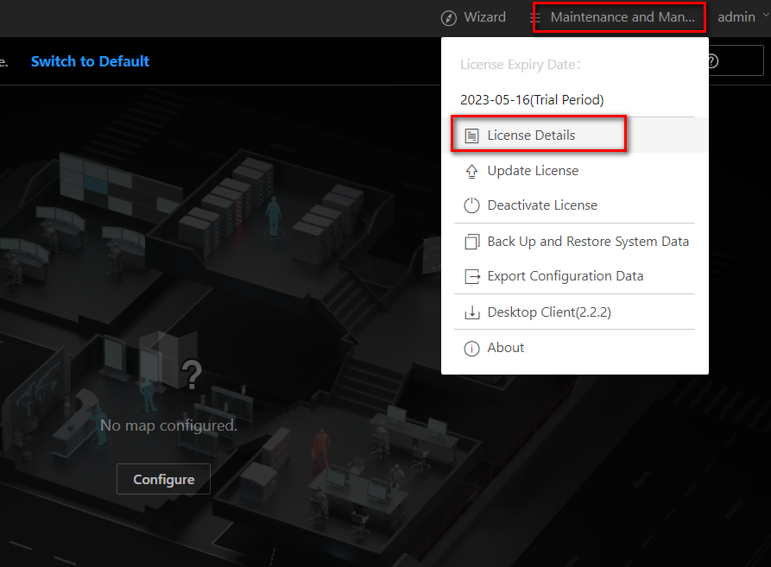
01
4.1.3 Add Thermal Presence Detector Device
Go to General → Resource Management → Device and Server → Encoding Device add the device.
Maintenance and Management → License Details → Cameras → Healthcare Thermal Camera configure the thermal camera

Slide 28
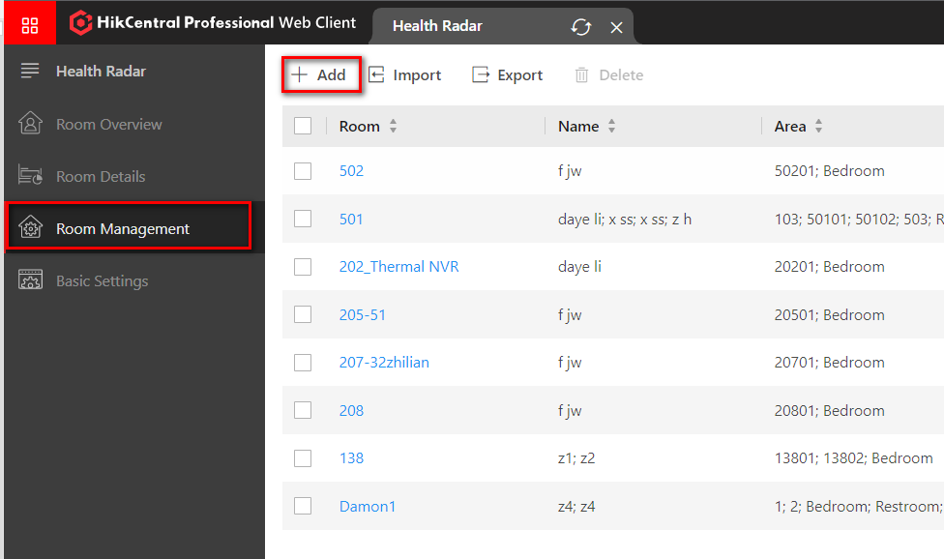
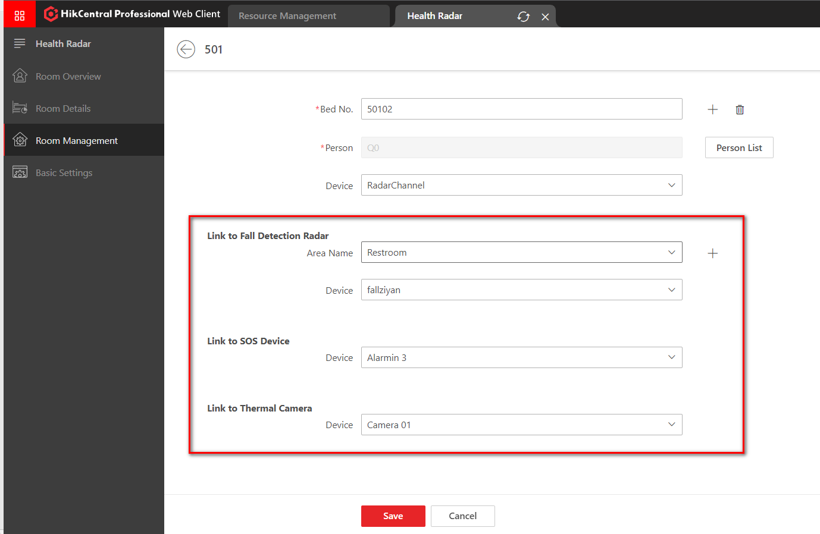
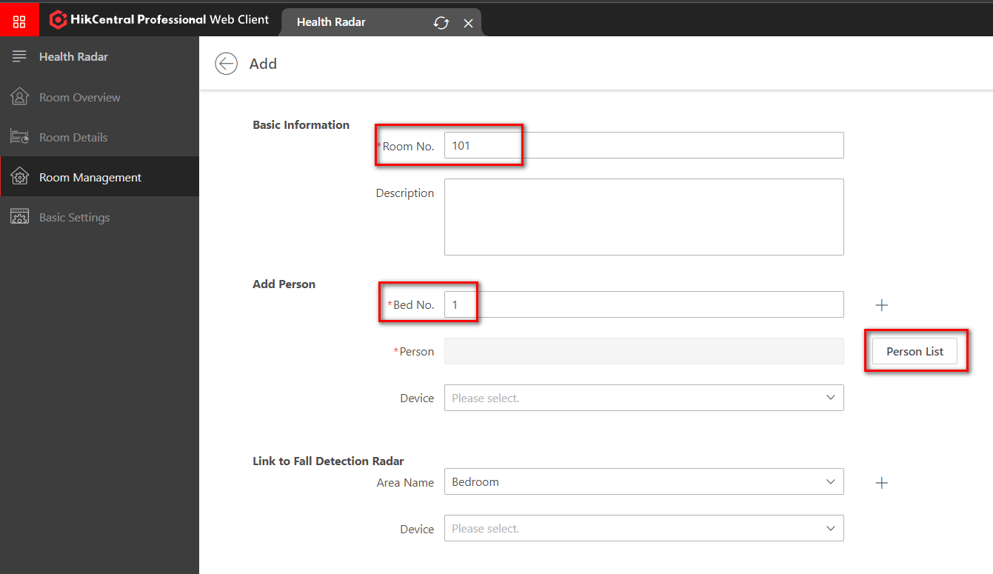
01
Room Management Configuration
Go to Health Radar → Room Management add Room.
Add Person : we can link Auxiliary care radar and person with the bed

Slide 29
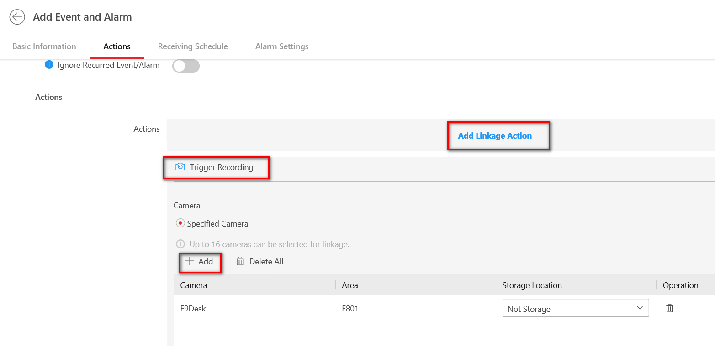
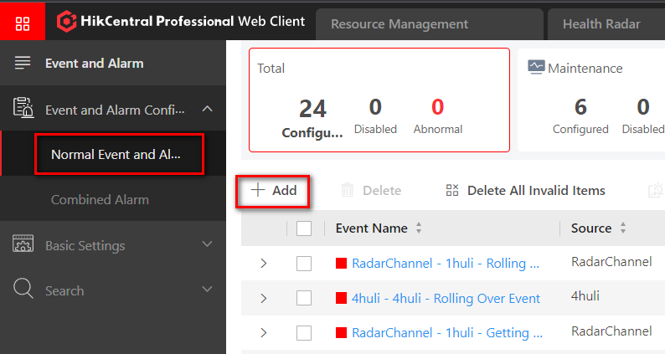
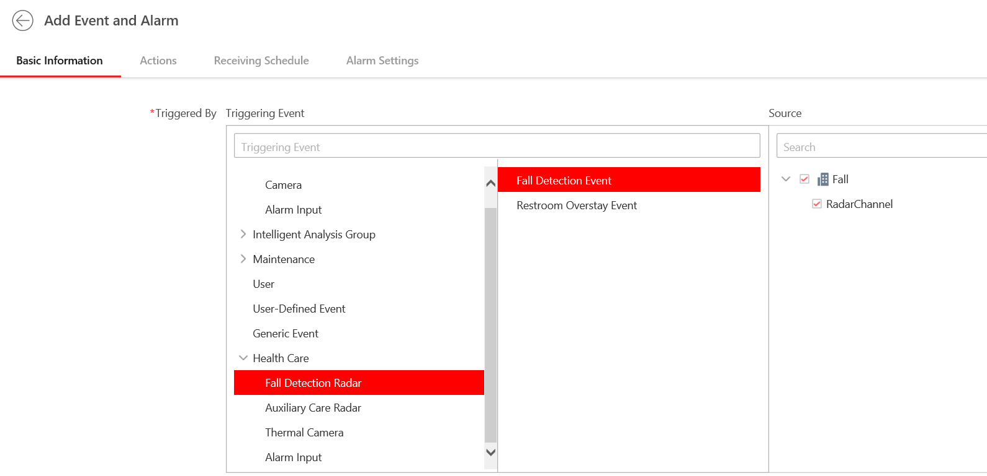
01
Alarm Configuration-- Falling Alarm
Go to Event and Alarm → Event and Alarm Configuration → Normal Event and Alarm add alarm.
We can link the thermal camera with the radar, then we can check the playback when the falling alarm trigered

Slide 30
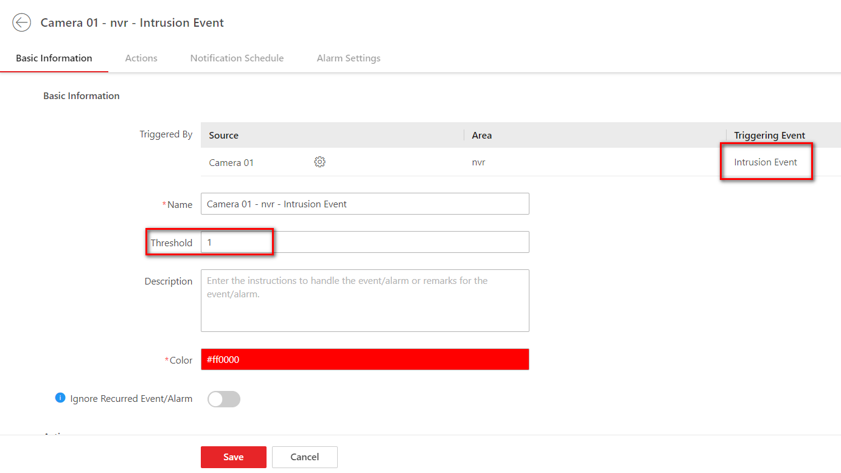
01
Alarm Configuration-- Intrusion Alarm
Threshold number means allow the number of additional people to enter this room
e.g: if there have 3 people live in this room, set the threshold as 2, then if there have 5 people stay in this room,
the thermal camera will trigger alarm

Slide 31
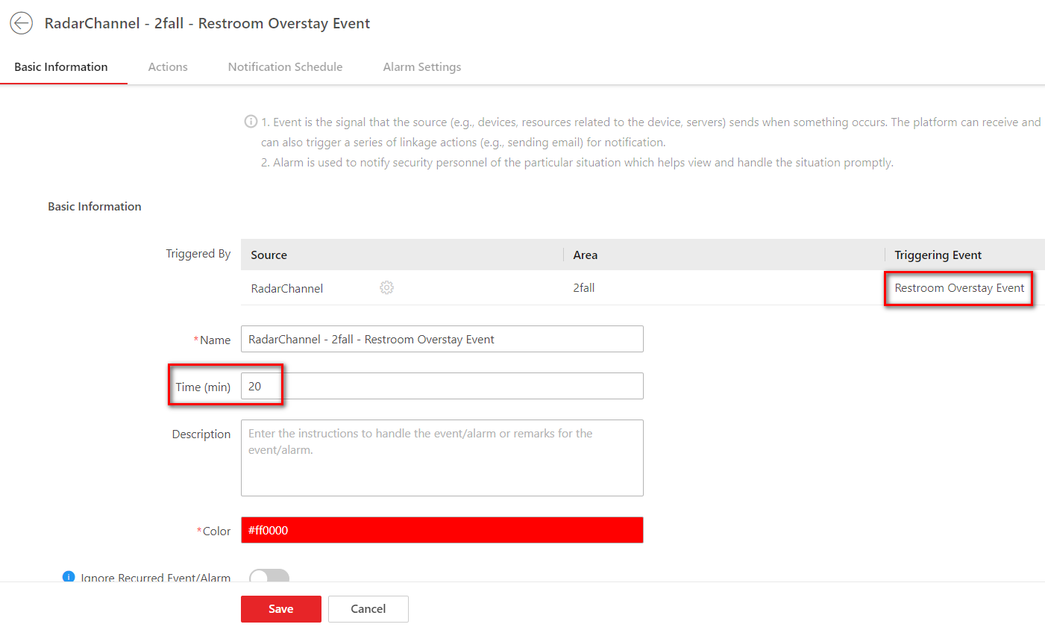
01
Alarm Configuration– Restroom overstay Alarm
Time in this rule means if the person stay in the restroom over this time the fall detection radar will trigger alarm

Slide 32
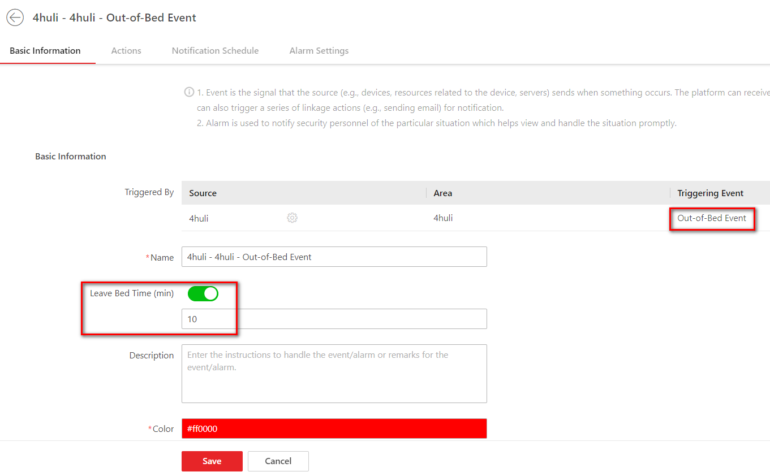
01
Alarm Configuration– Out-of-Bed Alarm
Leave Bed Time in this rule means if the person leave the bed over this time the Auxiliary Care Radar will trigger alarm

Slide 33
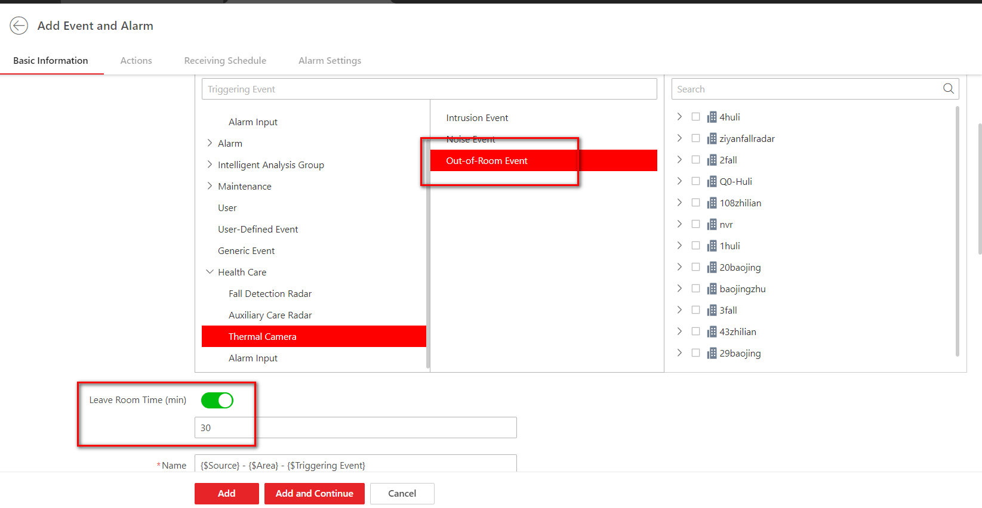
01
Alarm Configuration– Out-of-Room Alarm
Leave Room Time in this rule means if the person leave the room over this time the Fall Detection Radar will trigger alarm

Slide 34
P.03
Business & Function Verification

Slide 35
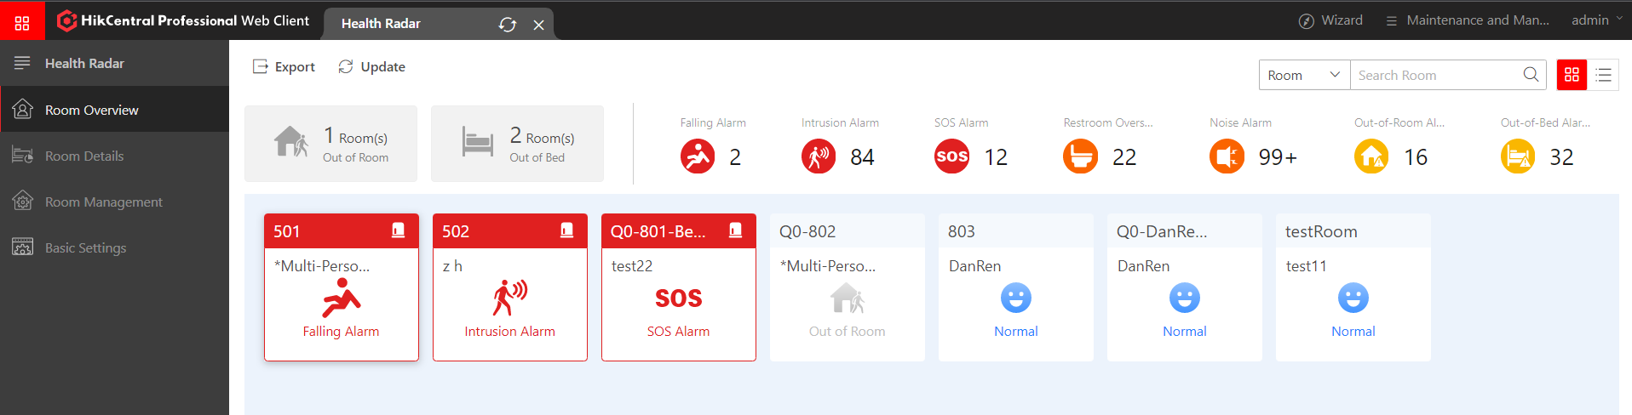
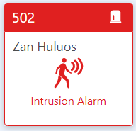
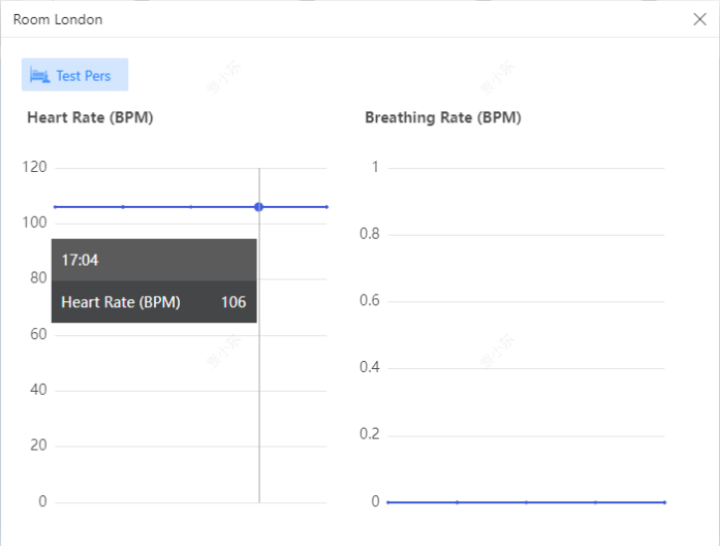
01
Function Verification – Room Overview
1
2
3
Area 1 : we can click the button to filter the rooms status in Area 3, Out of room or Out of bed.
Area 2 : we can receive those alarms after we add the alarm rules in Event and Alarm(need to handle those alarms in control client)
Room name
Click this area can go to room details
Area 3 ：room panel
Person name
Alarm status
Click this area can check the real time Heart Rate and Breathing Rate
Note: the Alarm status shows in priority, one room panel shows one alarm status even there happened more then one alarms
Alarm priority : Falling Alarm > Intrusion Alarm > SOS Alarm > Restroom Overstay Alarm > Nosie Alarm > Out-of-Room Alarm > Out-of-Bed Alarm

Slide 36
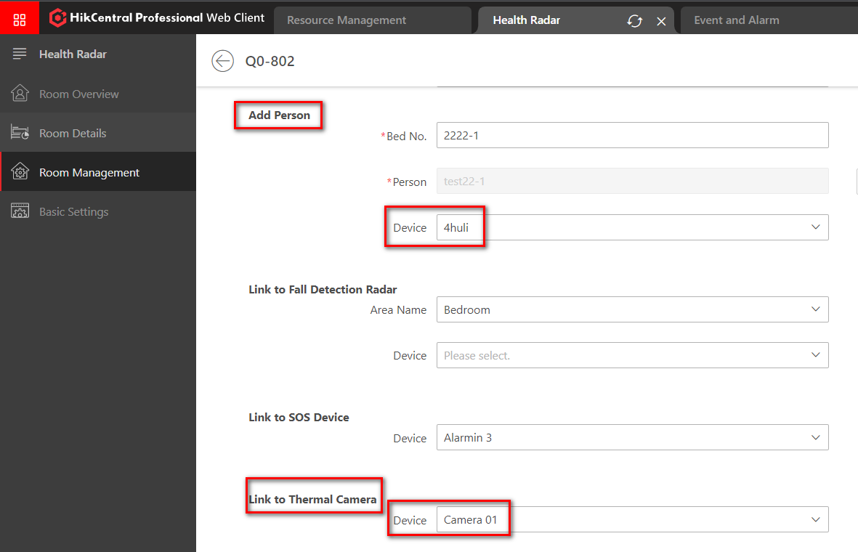
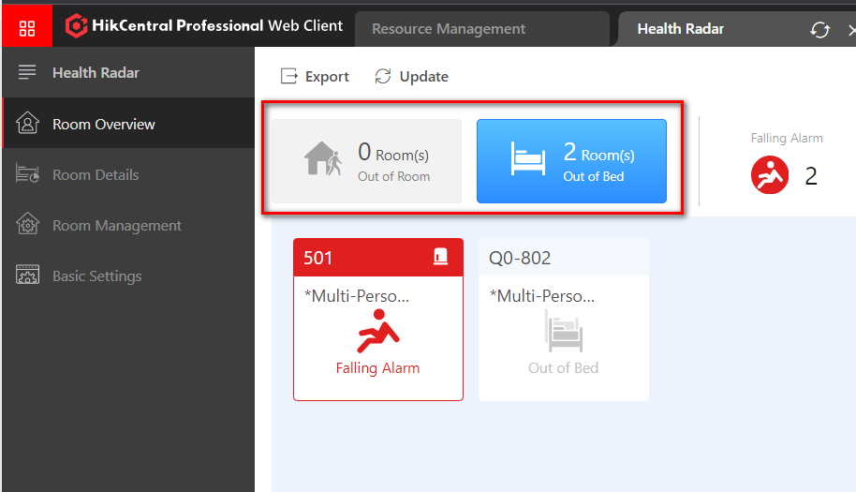
01
Function Verification – Room Overview
We can check the Out of Bed and Out of Room status(for single room) in the Room Overview after link the Auxiliary care radar with bed and link the Thermal camera with room
Note: we can check the Alarm status : out of room or out of bed, even don’t add the out-of-room alarm and out-of-bed alarm

Slide 37
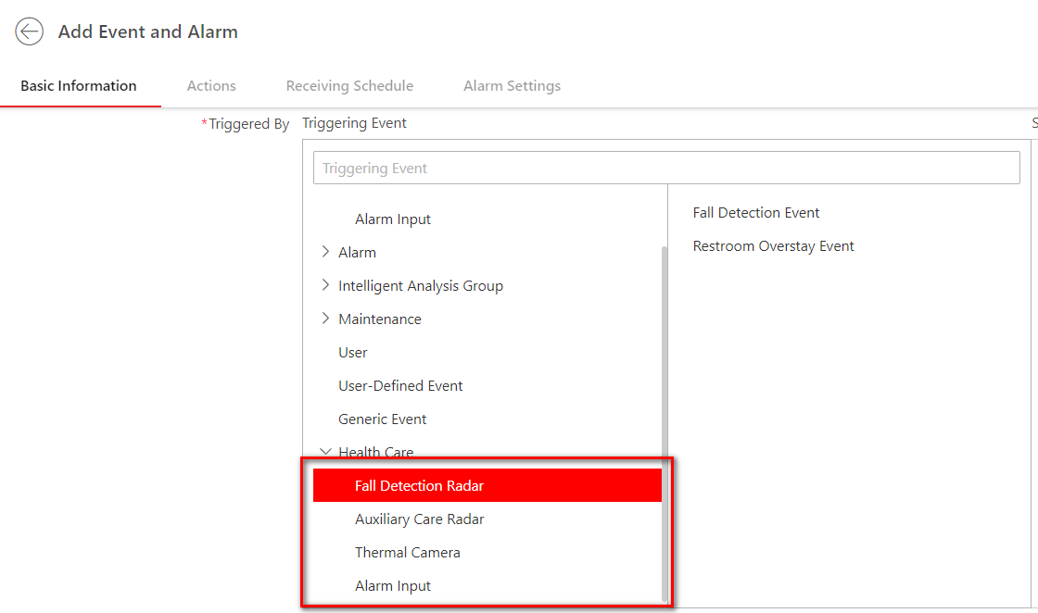
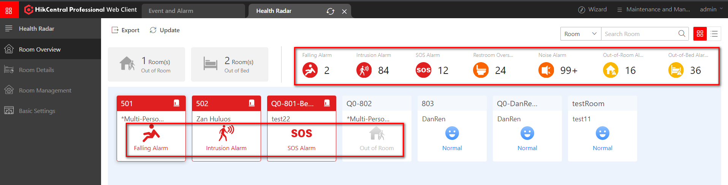
01
Function Verification – Room Overview
We can check the alarm status in room overview after add the alarm rules in Event and Alarm
Falling Alarm -- Trigger by Fall Detection Radar
Intrusion Alarm -- Trigger by Thermal camera（People Overstay）
SOS Alarm -- Trigger by Panic Alarm Station（Alarmin 3）
Restroom Overstay Alarm -- Trigger by Fall Detection Radar
Nosie Alarm -- Trigger by Thermal camera
Out-of-room Alarm -- Trigger by Thermal camera（Out of Room+ People Overstay ）
Out-of-bed Alarm -- Trigger by Auxiliary Care Radar

Slide 38
01
Function Verification – Function List
Please refer to the Business & Function Verification List to finish the verification.
Model | Function | Description
Room Overview | Out of Room/Out of Bed filtrate | we can check the room status by click the Out of Room/Out of Bed button
 | Room thumbnail/list switch | we can show the room information as thumbnail or list infor by click the thumbnail/list button
 | Room/Person search | we can search the room and person information in the top right corner
 | Unhandled alarm information | show the unhandled alarm numbers in room overview page
 | Show real-time health information | we can check the breath rate/heart rate information by click the room panel
 | Redirect to room details | we can redirect to the room details page by click the room name

Slide 39



01
Function Verification – Room Details
Area 1 : Room name
Area 2 : Person name
Area 3 : Different color-block means the stay duration in different area(for single room)
Area 4 : Not Handled alarm information
Area 5 : Receive data from Auxiliary Care Radar
Area 6 : Receive data from Auxiliary Care Radar
1
2
4
5
3
6

Slide 40


01
Function Verification – Room Details
If there have more then one person in this room, the area 3 can only show the stay duration in bed or out of bed
3

Slide 41
01
Function Verification – Function List
Please refer to the Business & Function Verification List to finish the verification.
Model | Function | Description
Room Details | Duration report in different area | we can check the time duration about the people stay in different area in the room(for single room)
 | Person information | we can check the person name, person ID, phone number, image of the person
 | Person status | we can check if the person in bed or in room
 | Unhandled alarm information | show the unhandled alarm numbers in this room
 | Sleep status | we can check deep sleep, light sleep, wakefulness times
 | Show health information | we can check the breath rate/heart rate information from the 00:00 of today

Slide 42

01
Function Verification – Control Client
We can receive and handle the alarm information in control client

Slide 43

01
Function Verification
We can realize two-way audio with the Panic Alarm Station via click the Answer button
Note: after trigger the SOS alarm, both control client and master station can receive the alarm

Slide 44
01
Function Verification – Function List
Please refer to the Business & Function Verification List to finish the verification.
Model | Function | Description
Alarm Center | Alarm handle | we can handle the alarm in the control client
 | Answer the sos alarm | we can realize two-way audio with the panic alarm station when we answer the sos alarm

